Slide 1
Waves and the Electromagnetic Spectrum
8th Grade Physical Science

Slide 2
Question:
What type of wave is a sound wave?

Slide 3
Waves 3/10/15
Wave—a repeating movement or disturbance that transfers energy through matter or space.
All waves carry energy without transporting matter from place to place.
Molecules pass energy to energy to neighbor molecules who then pass energy to neighbor
All waves are produced by vibrations
Waves will travel as long as there is energy to carry

Slide 4
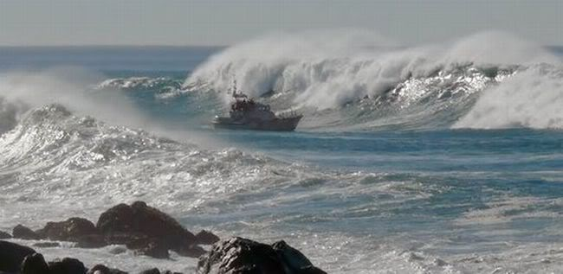
Waves move energy…. not matter.

Slide 5
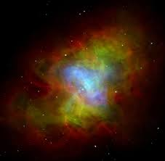
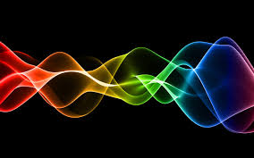
Medium—matter through which a wave travels
A medium can be solid, liquid, gas or combo of these.
Not all waves need a medium to travel—light and radio waves can travel through space.

Slide 6
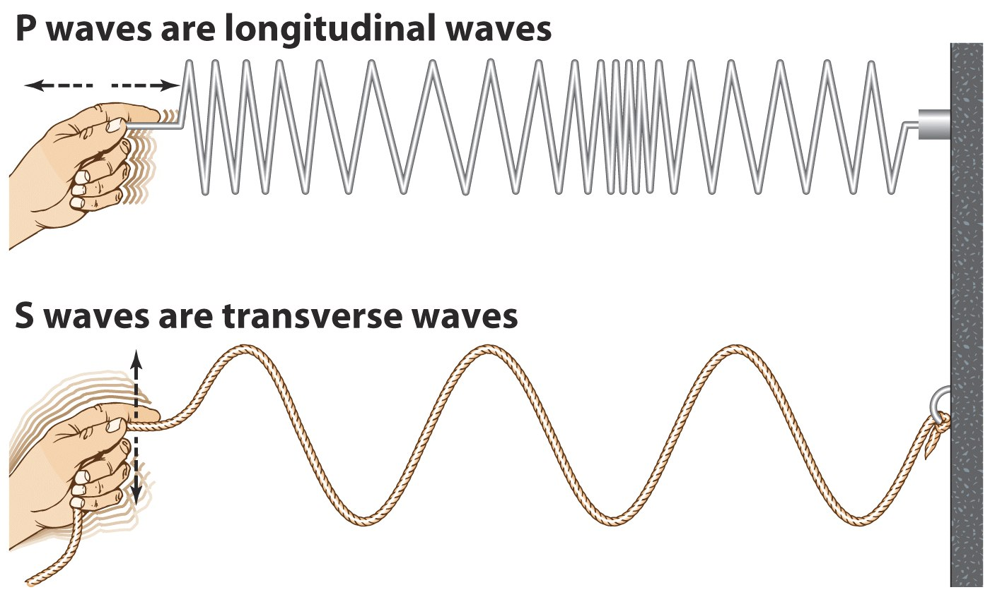
Mechanical Waves—waves that can only travel through medium.
Transverse Waves | Longitudinal Waves
Matter moves back and forth at right angles to direction that wave travels | Matter in medium moves in the same direction that wave travels

Slide 7
Question:
Which is faster sound waves or light waves?

Slide 8
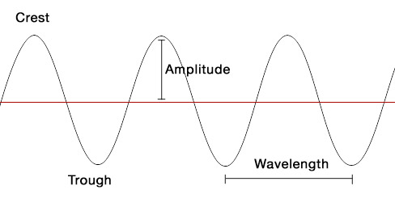
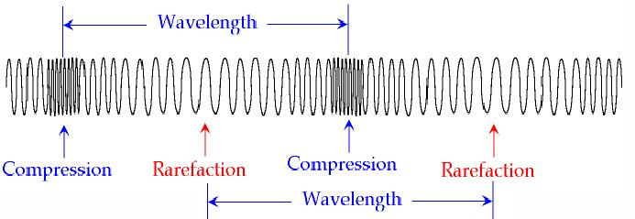
Features of Waves 9/10/15
Parts of a Wave
Transverse waves have crests—the highest points, and troughs—the lowest points of waves.
Compressional waves have dense regions (coils close together) called compressions and less dense regions called rarefactions.

Slide 9
Wavelength (λ)—distance between one point on a wave and similar point nearest to it (crest to crest, trough to trough, compression to compression or rarefaction to rarefaction)
*Wavelength of wave decreases as frequency increases
Frequency—number of wavelengths that pass a fixed point each second (hertz-Hz)
Calculating Wave Speed
Wave speed (m/s)=frequency (Hz) x Wavelength(λ)
v=fλ

Slide 10
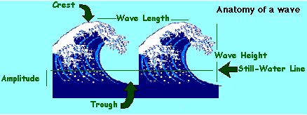
Amplitude—a measure of energy in a wave; the more energy a wave carries → greater amplitude
Distance from crest or trough to normal position in transverse wave
The denser the compression the larger the amplitude in longitudinal wave

Slide 11
Question:
What do an echo, a shadow and your reflection have in common?

Slide 12
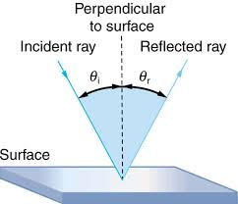
Behavior of Waves 9/12/15
Law of Reflection—the angle of incidence (i) of a wave is equal to the angle of reflection (r)
Reflection—occurs when a wave strikes an object and bounces of it—all types of waves can be reflected (ex. sound, water & light)

Slide 13
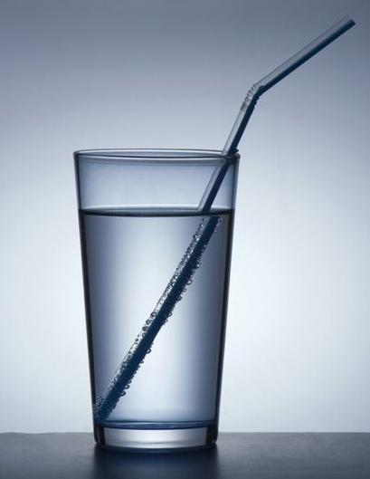
Refraction—bending of a wave caused by a change in its speed as it moves from one medium to another.
*The greater the change in speed the more the wave bends.
Diffraction—an object causes a wave to change direction and bend toward it.
*Both refraction and diffraction cause waves to bend however, refraction occurs when waves pass through an object while diffraction occurs when waves pass around an object.
Notes:
Straw in water looks broken due to refraction
Waves go around the rock due to diffraction

Slide 14
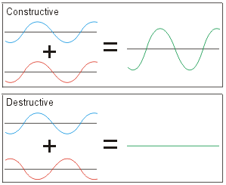
Inference—when two or more waves overlap and combine to form a new wave.

Slide 15
Question:
What causes electromagnetic waves?

Slide 16
Electromagnetic Spectrum 3/17/15
Electromagnetic waves—made by vibrating electric charges and can travel through space.
Frequency of electromagnetic waves is the number of vibrations per second (Hz)
Electromagnetic Spectrum—the entire range of electromagnetic wave frequencies

Slide 17
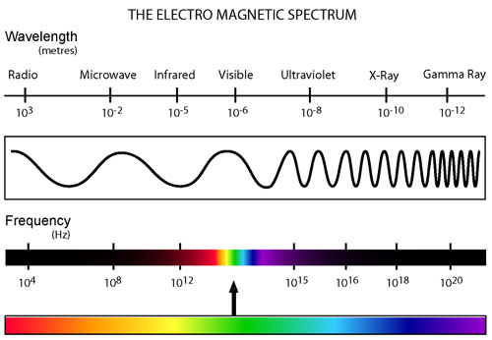

Slide 18
The Electromagnetic Spectrum includes:
Radio waves—low frequency waves with wavelengths of about 1-10cm (radio stations, microwaves, radar)
Infrared waves—have slightly higher frequency than radio waves (remote control, warmth of fire, satellites)
Visible light—range of electromagnetic waves you can detect with your eyes (ROYGBIV—different colors have different wavelengths)

Slide 19
The Electromagnetic Spectrum includes (contuid):
Ultraviolet waves—frequencies slightly higher than visible light (sunburns, vitamin D production, fluorescent materials absorb it, kills bacteria)
X Rays & Gamma Rays—ultra-high frequencies that can travel through matter, damage cells (bone images, radiation therapy, production of superhero—Hulk)

