Slide 1
Question:
How does the fossil record provide evidence for the theory of evolution?

Slide 2
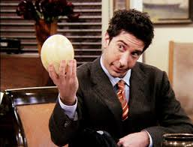
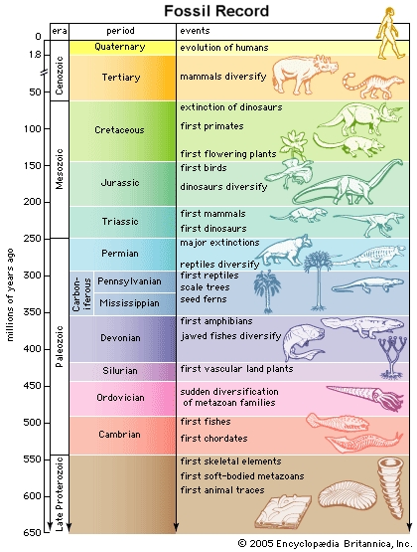
The Fossil Record 3/11/15
Paleontologist—scientist who studies fossils, or the preserved remains or traces of organisms that lived in the past.
Fossil record—collections of fossils organized to proved evidence about history of life on Earth, including how organisms have changed overtime.

Slide 3
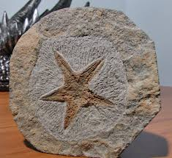
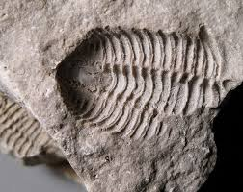
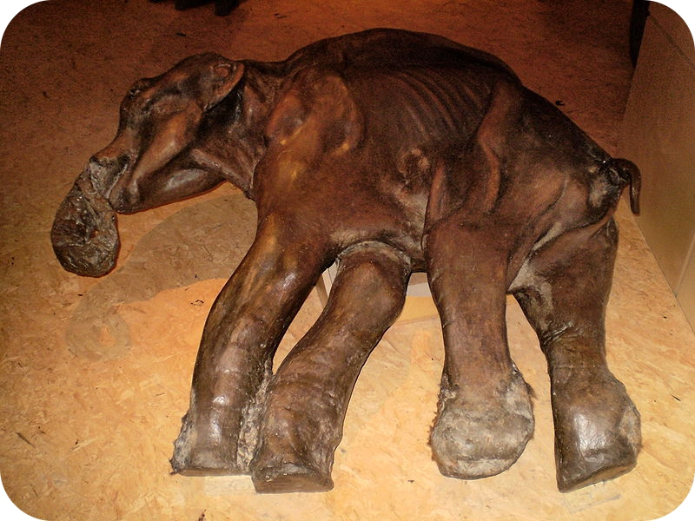
The formation of fossils are rare events but can occur by:
Petrified fossils | Molds and Casts | Preserved Remains
Remains are buried in sediment then change to rock over time | Hollow spaces in sediment in the shape of an organism is called a mold; when a mold becomes filled with hardened materials it becomes a cast | Quickly buried organisms are preserved by ice, volcanic ash or clay before they begin to decay

Slide 4
Relative Dating:
Age of fossils are determined by comparing its placement with that of fossils in other layers of rock
Radioactive Dating:
Involves measuring the amounts of radioactive isotopes in a sample to determine its actual age
Paleontologists use the geological time scale or a “calendar” of Earth’s history, to represent evolutionary time.
After Precambrian Time, the geological time scale is divided into eras (Paleozoic, Mesozoic and Cenozoic) and those are subdivided into periods, which range in length from tens of millions of years to less than two million years.

Slide 5
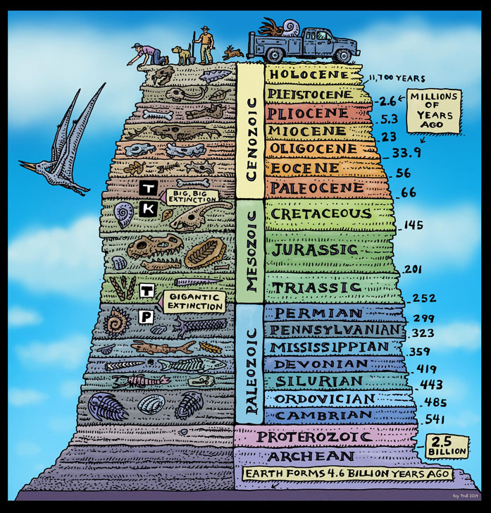

Slide 6
Question:
What is taxonomy?

Slide 7
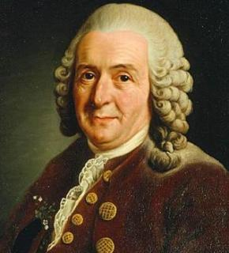
Classification 3/16/15
In the 1730s, Carolus Linnaeus, a Swedish botanist, developed a two-word naming system called binomial nomenclature—first part of name is genus with second part of name referring to species.
Linnaeus also developed a classification system which included seven hierarchical taxa:
KINGDOM | PHYLUM | CLASS | ORDER | FAMILY | GENUS | SPECIES
Animalia | Chordata | Mammalia | Carnivera | Ursidae | Ursus | Ursus arctos

Slide 10
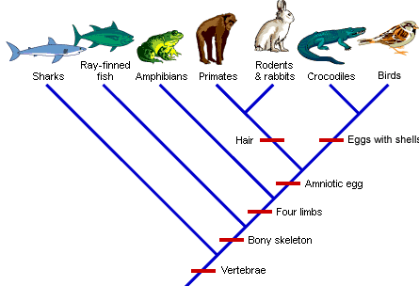
Sometimes classification keys are used to identify organisms by traits that are visible, however scientists today look at how closely members of groups are related.
Phylogeny—study of how living and extinct organisms are related to one another
Clade—group of species that includes a single common ancestor and all descendants of that ancestor
Notes:
clade: Greek klados or “branch”

Slide 11
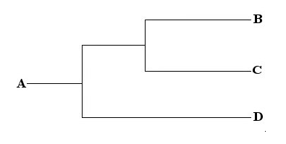
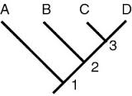
Cladogram—diagram that links groups of organisms by showing how evolutionary lines, or lineages, branched off from common ancestors
Derived Character—trait that arose in the most recent common ancestor of a particular lineage and passed to its descendants.

