Slide 1
More Body Systems
7th Grade Life Science

Slide 2
Question:
How are particles of foreign matter expelled from the respiratory system?

Slide 3
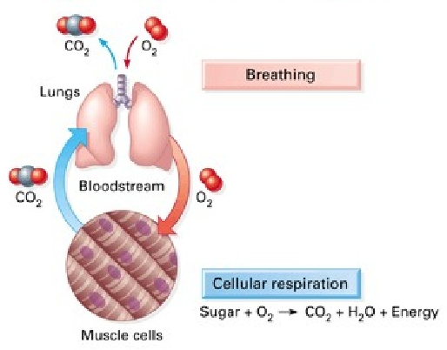
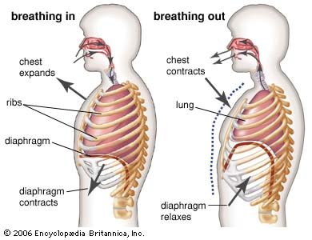
Respiratory System
Respiratory System- main function is to supply oxygen to body and remove carbon dioxide and water.
Breathing | Respiration
Movement of the chest that brings air into body through lungs | Chemical reaction used by cells to release energy from glucose; produces CO₂ and H₂0 as waste

Slide 4
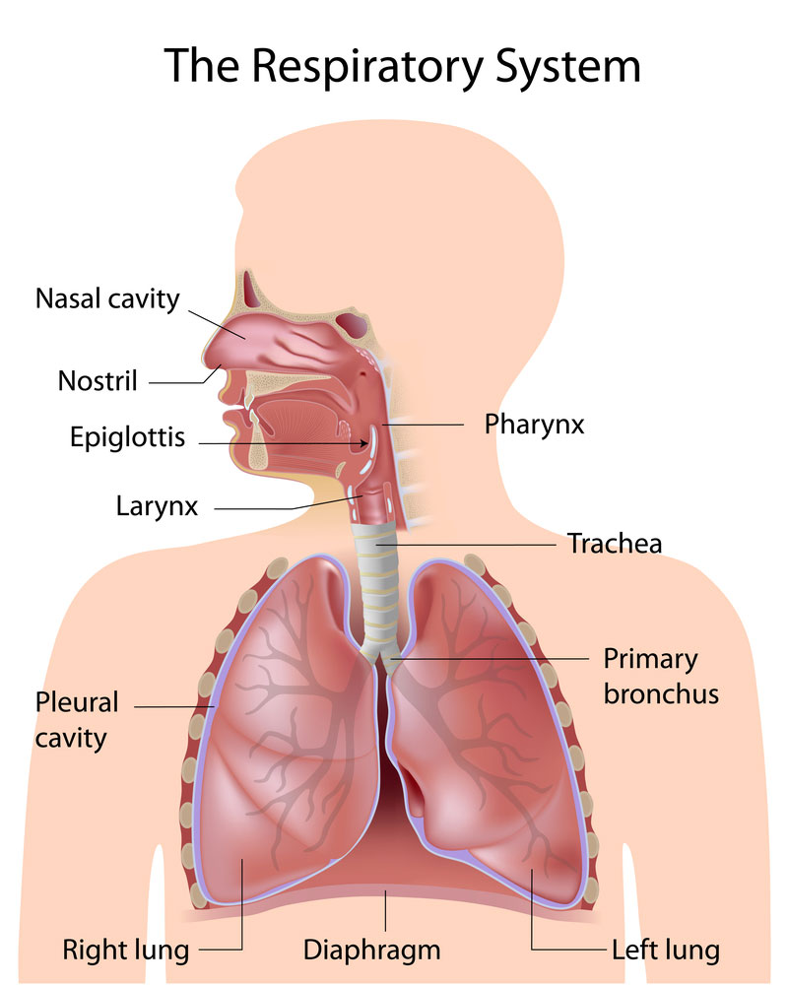
Organs of the Respiratory System:
Nose- air enters the body through into nasal cavities which are lined with cells called cilia, or tiny hair-like projections that move together in a sweeping motion
Pharynx- aka throat; air enters the tube-like passageway also used by food and liquid (contains larynx-contains vocal cords)

Slide 5
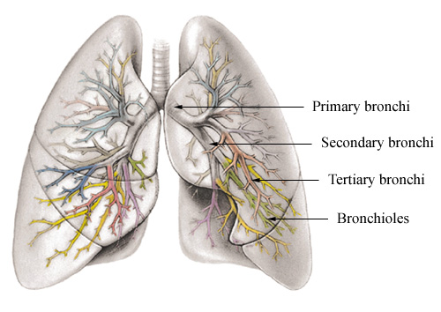
Trachea- tube held open by ring of cartilage called windpipe; lined with cilia and mucous
Epiglottis- small flap of tissue that folds over trachea which prevents food or liquid from entering
Bronchi and Lungs- bronchi are passages that direct air into lungs. The lungs are the main organs of the respiratory system.
Bronchioles are smallest tubes of bronchi which end in clusters called alveoli which are tiny sacs of lung tissue specialized for movement of gases between air and blood.

Slide 6
Question:
What might happened if kidneys did not remove wastes from blood?

Slide 7
Excretory System
Excretory System- eliminates urea, excess water and other wastes from your body
The structures of the excretory system include:
The kidneys- major organs of the excretory system that remove wastes but keep materials your body needs
Each kidney contains about a million nephrons, tiny filtering “factories” that remove waste from blood and produce urine

Slide 8
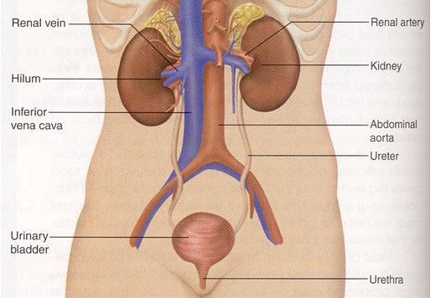

Slide 9
The nephrons filter waste in stages:
Blood flows from artery into a nephron in the kidney.
Blood reaches cluster of capillaries- urea, water, glucose and other materials are filtered from blood.
Removed waste materials pass into a long, twisting tube surrounded by capillaries.
As filtered materials flow through tube, water and glucose are reabsorbed into the blood; urea stays in the tube.
After reabsorbing process is complete, liquid that remains is called urine.

Slide 10
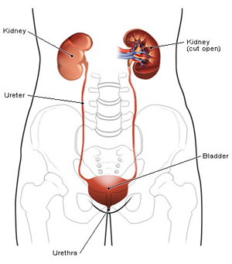
Ureters- urine flows from the kidney through these narrow tubes and carry urine to the urinary bladder
Urinary bladder- saclike muscular organ that stores urine
Urethra- small tube in which urine leaves the body

Slide 11
Question:
What are the three main types of blood vessels?

Slide 12
Cardiovascular System
Cardiovascular system- carries needed substances to cells and carries waste products away from cells; blood also contains cells that fight diseases
It includes:
The Heart- hollow, muscular organ that pumps blood throughout the body- each heart beat pushes blood through the blood vessels.
Has four chambers- atrium are the upper two; ventricle are the lower two chambers
Septum is a wall that separates the right from the left side
Pacemaker- group of cells located in right atrium that sends out a signal to make heart contract
Valves- Separate atria from ventricles and prevent blood from flowing backward.

Slide 13
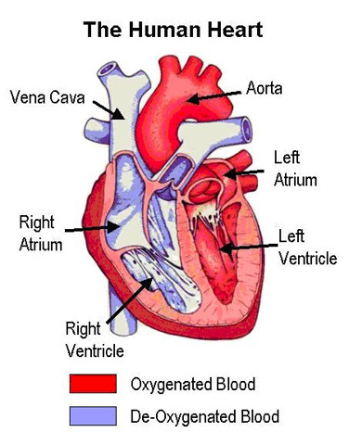

Slide 14
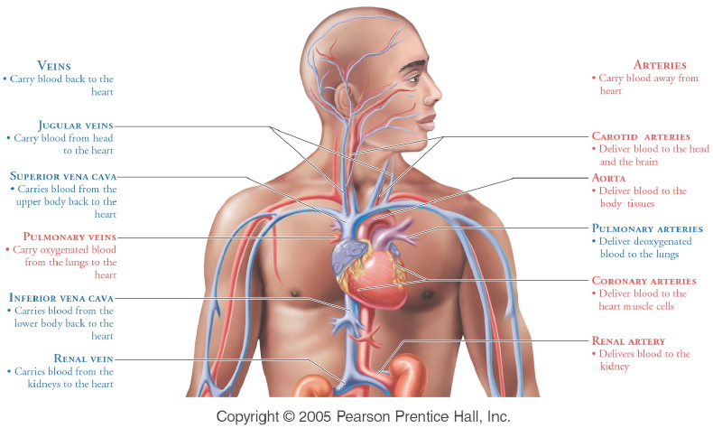
Blood Vessels- carry blood to every part of your body
Arteries- blood vessels that move blood away from heart
Veins- carry blood back to heart
Capillaries- microscopic blood vessels that connect arteries to veins
Blood pressure- force of blood on the walls of the blood vessels

Slide 15
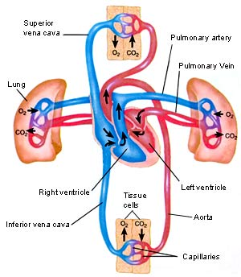
Pattern of blood flow→ through two loops with heart at center
Loop one: Blood travels from the heart to the lungs and then back to the heart.
Loop two: Blood is pumped from the heart throughout the body and then returns to the heart.

Slide 16
Question:
When does a female body develop eggs?

Slide 17
Endocrine & Reproductive Systems
Endocrine System- produces chemicals that control many of the body’s daily activities; regulates long-term changes such as growth and development
Endocrine glands- produce and release hormones, chemical products, directly into bloodstream
Hormones only interact with target cells, or those that recognize the hormones chemical structure
Includes the hypothalamus, pituitary, thyroid, parathyroid, adrenal, thymus, and pancreas.
Also includes the ovaries in females and testes in males.

Slide 18
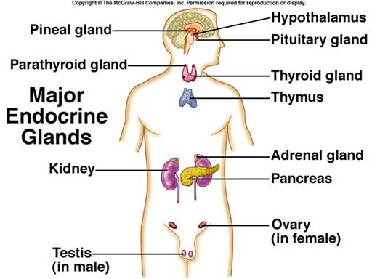

Slide 19
Ultimate result of reproductive process is the formation and union of egg and sperm, development of fetus and birth of an infant
Male Reproductive System | Female Reproductive System
Testes- organs of male reproductive system which produce sperm and are located the scrotum Semen-mixture of sperm and fluids that leave body through organ called penis. | Ovaries- female reproductive structure that produce eggs. Each ovary is located near a fallopian tube (oviducts) where eggs travel down to the uterus, a muscular organ. An unfertilized egg leaves the uterus through the cervix into the vagina.

Slide 20
