Slide 1
Question:
If humans have a diploid number of 46 chromosomes, what is the haploid number of chromosomes?

Slide 2
Meiosis 2/18/15
Meiosis- a type of cell division that produces four cells, each with half the number of chromosomes as the parent cell.
In animals, meiosis occurs in the sex organs—the testes in males and the ovaries in females.
A gamete, or sex cell is a haploid cell, meaning this cell contains only one of each kind of chromosome verses a diploid cell found in body cells, which have two of each kind of chromosome.

Slide 3
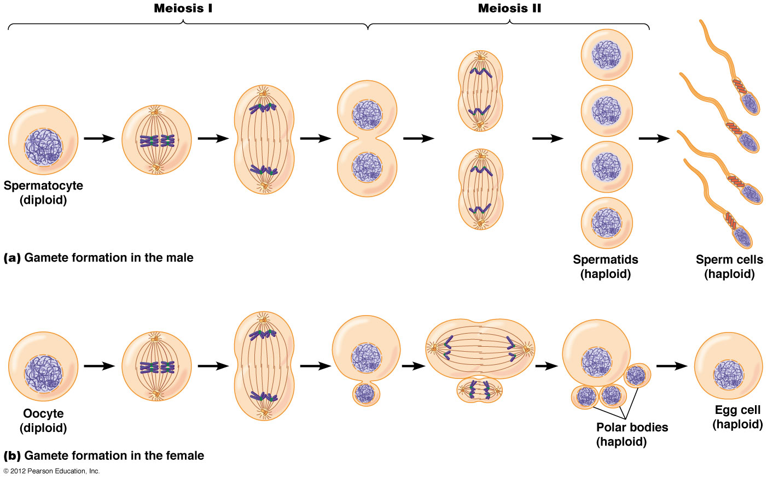
*Mitosis results in the production of two genetically identical diploid cells, whereas meiosis produces four genetically different haploid cells in two stages known as the 1st and 2nd meiotic divisions.

Slide 4
Question:
Why do some traits exhibit a large number of phenotypes?

Slide 5
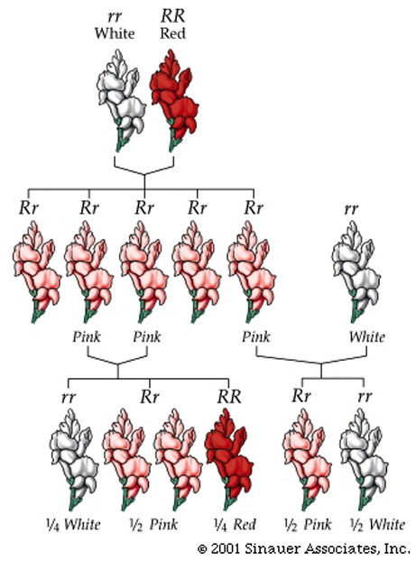
Complex Patterns of Inheritance 2/23/15
Incomplete dominance- when neither allele of the parents is completely dominant, the phenotype of the heterozygous offspring is a mix of parents.
Example:
red snapdragon x white snapdragon → pink snapdragons

Slide 6
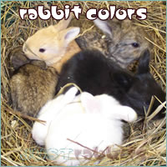
Codominant alleles- both alleles show equally
Example: black chicken x white chicken → speckled chicken
Multiple alleles- there are more than two alleles for a genetic trait
Example: a rabbit’s coat color—four possible colors

Slide 7
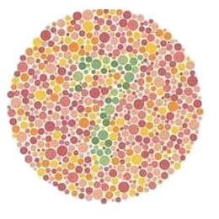
Humans have 23 pairs of chromosomes. 22 pairs of homologous chromosomes are called autosomes. The 23rd pair is called the sex chromosomes, which are indicated by X for females and Y for males.
Sex-linked traits- traits controlled by genes located on sex chromosomes (Ex. Colorblindness)

Slide 8
Polygenic inheritance- inheritance pattern of a trait that is controlled by two or more genes (Ex. Skin color and height)
* Nutrition, light, chemicals, infectious agents such as bacteria, fungi, parasites and viruses can all influence how genes are expressed.

Slide 9
Question:
What does mRNA and tRNA stand for?

Slide 10
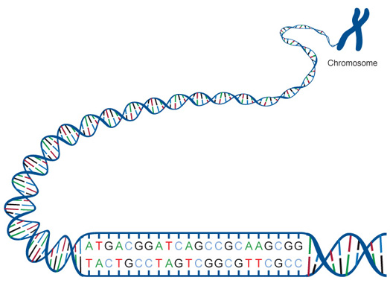
The Genetic Code 2/23/15
Gene- a section of a DNA molecule that contains the information to code for one specific protein
The order of the nitrogen bases (guanine, cytosine, adenine & thymine) along a gene forms a genetic code that specifies what type of protein will be produced.

Slide 11
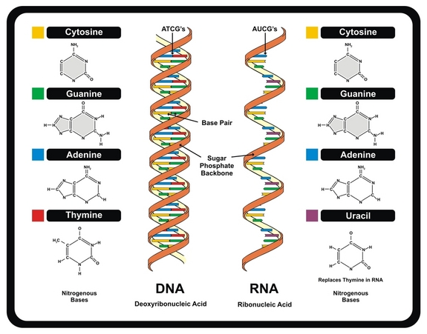
RNA- (ribonucleic acid) genetic “messenger” which carries genetic code from the DNA inside the nucleus into the cytoplasm.
Messenger RNA- copies coded message from DNA and carries message to ribosome in the cytoplasm
Transfer RNA- carries amino acids to the ribosome and adds them to growing protein
 | DNA | RNA
# Strands | 2 | 1
Sugar | Deoxyribose | Ribose
Nitrogen Bases | A, G, C, T | A, G, C, U (Uracil)

Slide 13
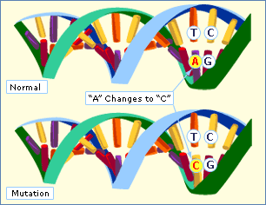
Mutation: any change in a gene or chromosome
If the original DNA sequence reads:
THE RED HAT
Substitution: THE RED CAT
Deletion: THE REC AT
Addition: THE READ HAT

