Slide 1
Electricity and Magnetism
8th grade Physical Science

Slide 2
Question:
How is lightning similar to getting an electric shock when you reach for a metal doorknob?

Slide 3
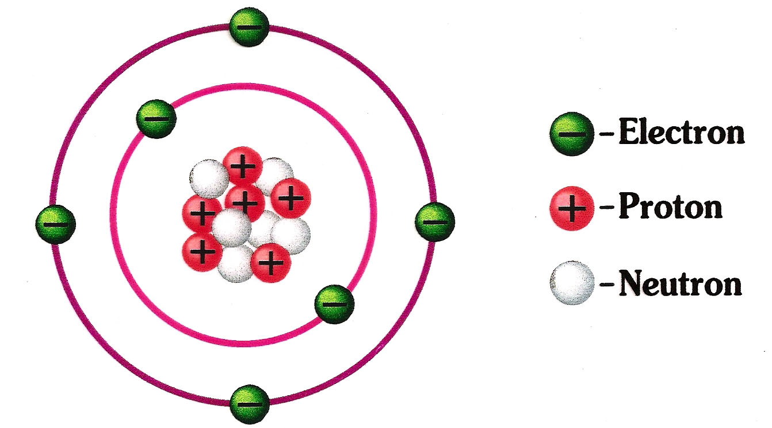
Electricity 1/27/15
Electric charges are from protons which are positive and electrons which are negative
Static Electricity- accumulation of excess electric charges on an object
Atoms become charged by gaining or losing electrons.

Slide 4
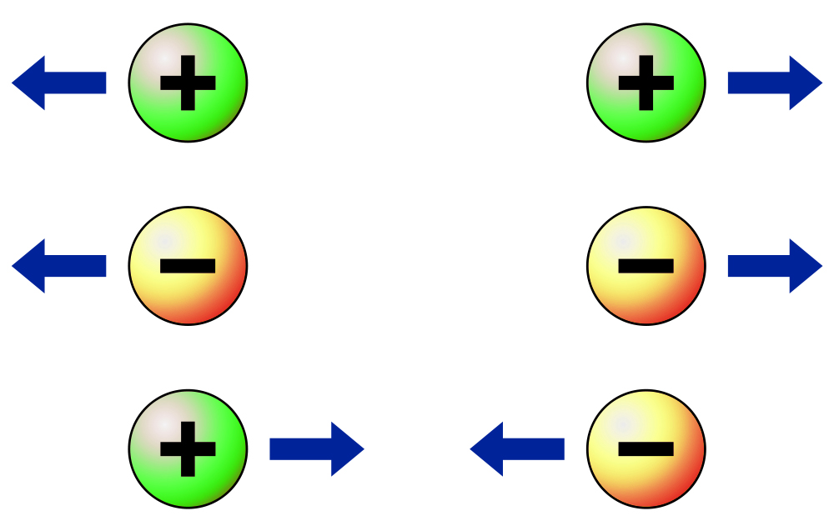
Law of Conservation of Charge- electric charges can be transferred from object to object, but it cannot be created or destroyed.
Positive and negative charges exert forces on each other.

Slide 5
Conductors vs. Insulators
Charging Objects
Conductors: material in which electrons move easily. (Ex. Metals) | Insulators: material in which electrons are not able to move easily. (Ex. Wood, plastic, rubber.)
Charging by contact: process of transferring charge by touching or rubbing | Charging by induction: rearrangement of electrons on a neutral object caused by nearby charged objects

Slide 6
Question:
What property of electric current allowed Edison’s first light bulb to light?

Slide 7
Electric Current 2/3/15
Electric current- net movement of electric charges in a single direction through a wire or conductor.
Voltage difference- force that causes electric charges to flow; charges flow from high voltage → low voltage.
Circuit- a closed path that electric current follows
Battery, wires, and voltage difference allows current to flow.

Slide 8
Batteries
Dry-Cell | Wet-Cell
Chemical reactions occur in a moist paste causing transfer of electrons | Contains two connected plates made of different metals in conducting solution.

Slide 9
Resistance- tendency for a material to oppose the flow of electrons, changing electrical energy into thermal and light energy
Making wires thinner, longer or hotter increases resistance.
All materials have some electrical resistance measured in ohms (Ω)
Ohms' Law-current in a current equals voltage difference divided by resistance.

Slide 10
Question:
Why does your home have a circuit breaker or fuse box?

Slide 11
Electric Circuits 2/5/15
Circuit Symbols
Series Circuit | Parallel Circuit
Current has only one loop to flow through. Examples: flashlight; holiday light | Contains two or more branches for current to flow through. Examples: homes; automobiles
Complex Circuit A circuit composed of both series and parallel circuits.

Slide 12
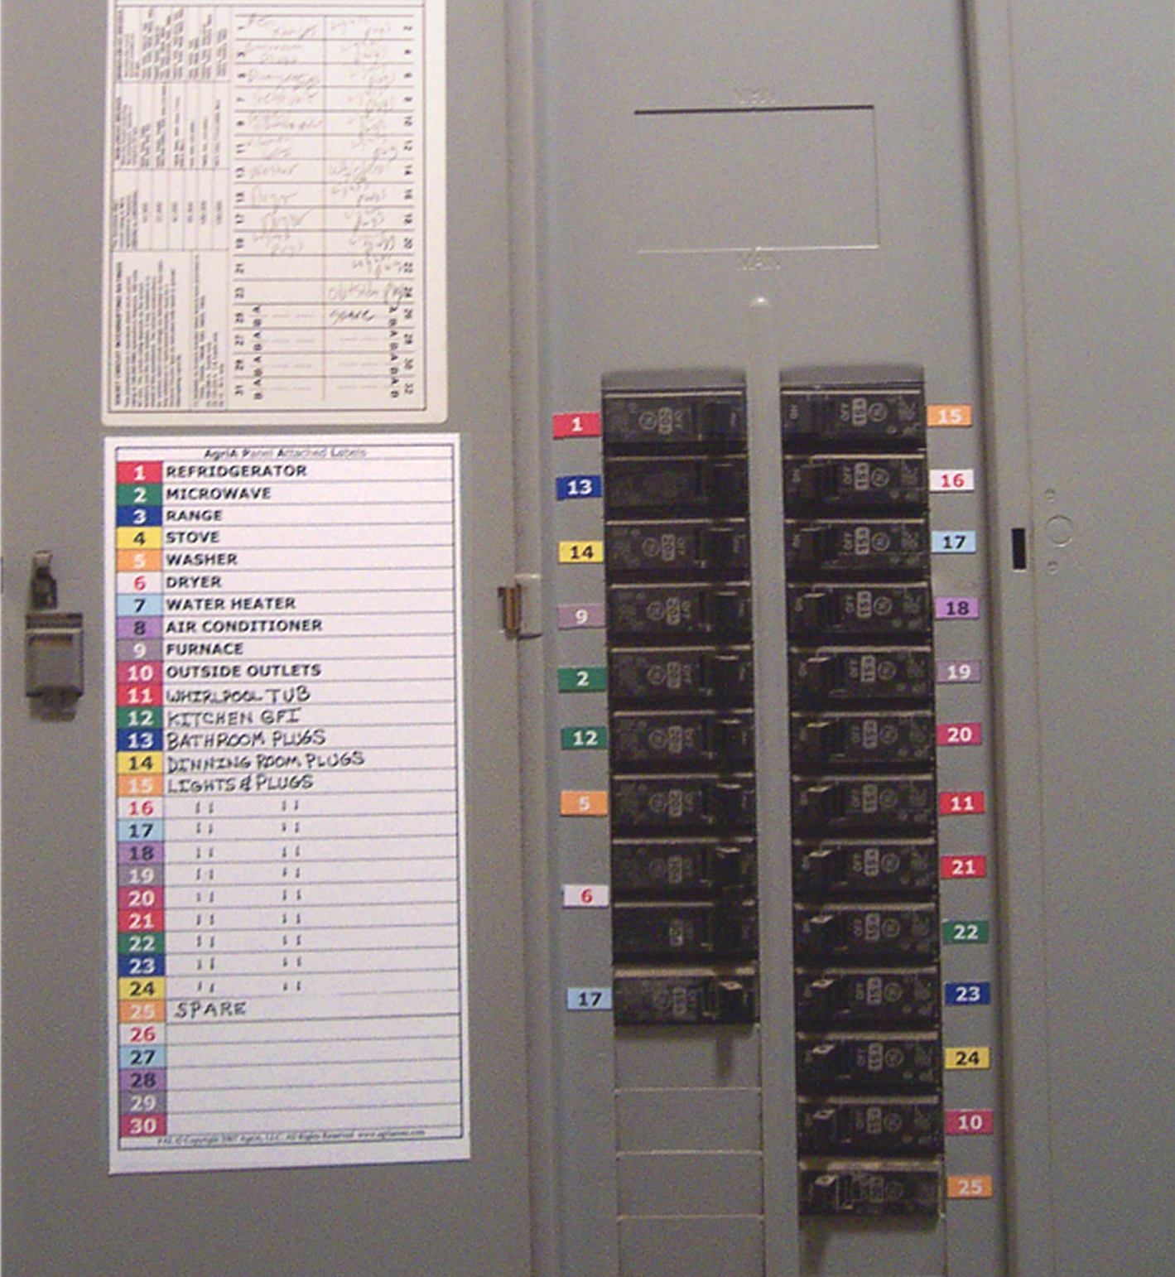
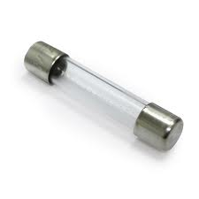
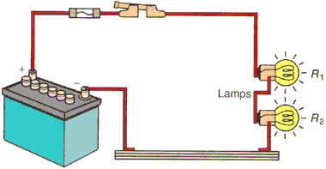
Electrical energy enters your home at the circuit breaker or fuse box and branches out to appliances, wall sockets, and lights.
Circuit breaker- small piece of metal that bends when it gets hot, opening circuit and stopping current flow.
Electric fuse- small piece of metal that melts if current becomes too high, opening circuit.

