Slide 1
Question:
Why are magnets so important?

Slide 2
Magnetism 2/19/15
Magnetism- refers to the properties and interactions of magnets in which there is a force of attraction or repulsion between like or unlike poles.
Strength of force between two magnets depends on the distance between them.

Slide 3
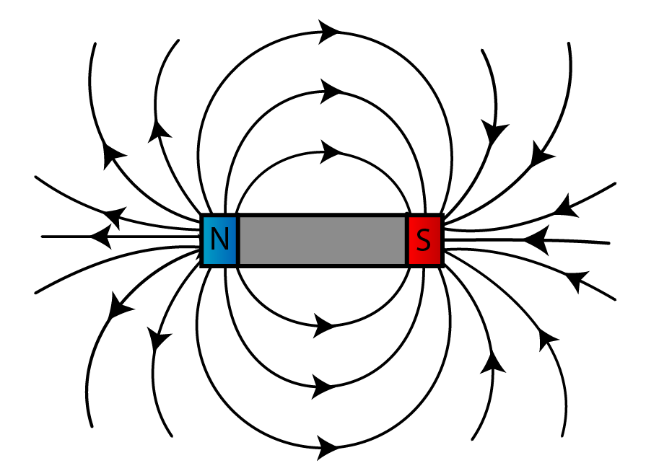
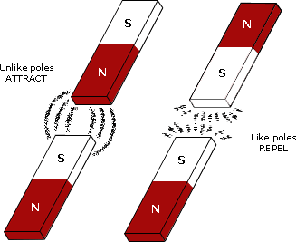
Magnetic field- exerts a force on the other magnets and objects made of magnetic materials (strongest closest to magnet)
All magnets have a north pole and south pole.

Slide 4
Magnetic Materials
Only a few metals, such as iron, cobalt, and nickel are attracted to magnets or can be made into permanent magnets.
Magnetic domains- group of atoms with aligned magnetic poles (two small to be seen with eye)
Permanent magnets are made by placing a magnetic material in a strong magnetic field, forcing magnetic domains to line up.

Slide 5
Question:
How does a stereo speaker use an electromagnet to produce sound?

Slide 6
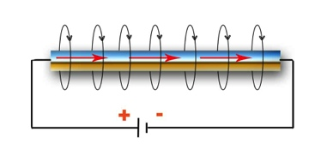
Magnetism and Electricity 2/19/15
When electric current flows through a wire, a magnetic field forms around the wire.
Strength of magnetic field depends on the amount of current flowing in the wire.

Slide 7
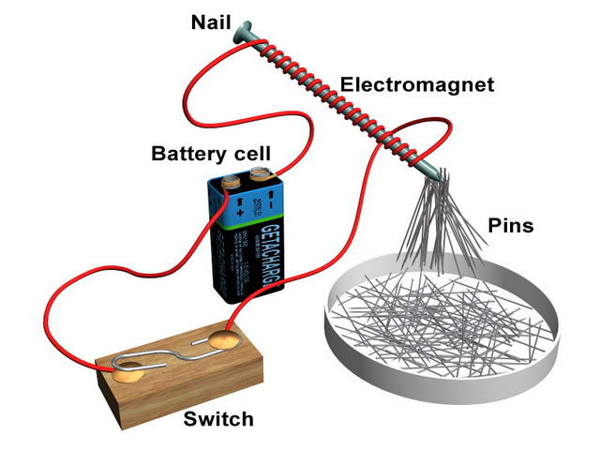
Electromagnets- a temporary magnet made by wrapping a wire coil carrying a current around an iron core.
Increase strength of the magnetic field by adding more turns to wire coil (solenoid) or increasing the current passing through the wire.

Slide 8
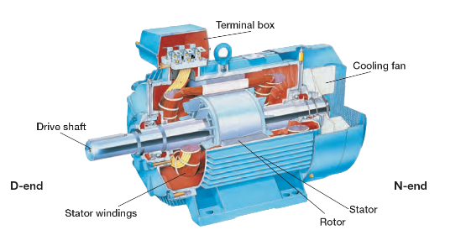
Electric motor- a device that changes electrical energy into mechanical energy
In a simple electric motor, an electromagnet rotates between the poles of a permanent magnet.

Slide 9
Direct and Alternating Current
Direct Current (DC)- Current that flows in only one direction through a wire
(Ex. Battery)
Alternating Current (AC)- Reverses the direction of the current flow in regular patterns
(Ex. Plugging toaster into wall outlet)

