Slide 1
Body Systems
7th Grade Life Science

Slide 2
Question:
How are humans classified?

Slide 3
Vertebrates 4/15/15
Chordates- organisms with a notochord, a flexible rod that supports the chordates back, a nerve cord, and slits in their throat area.
*Most chordates are vertebrates*
Vertebrate- animal with a backbone that is part of an endoskeleton, which supports the body, protects organs and gives muscles a place to attach.
(Fish, amphibians, reptiles, birds, mammals)

Slide 4
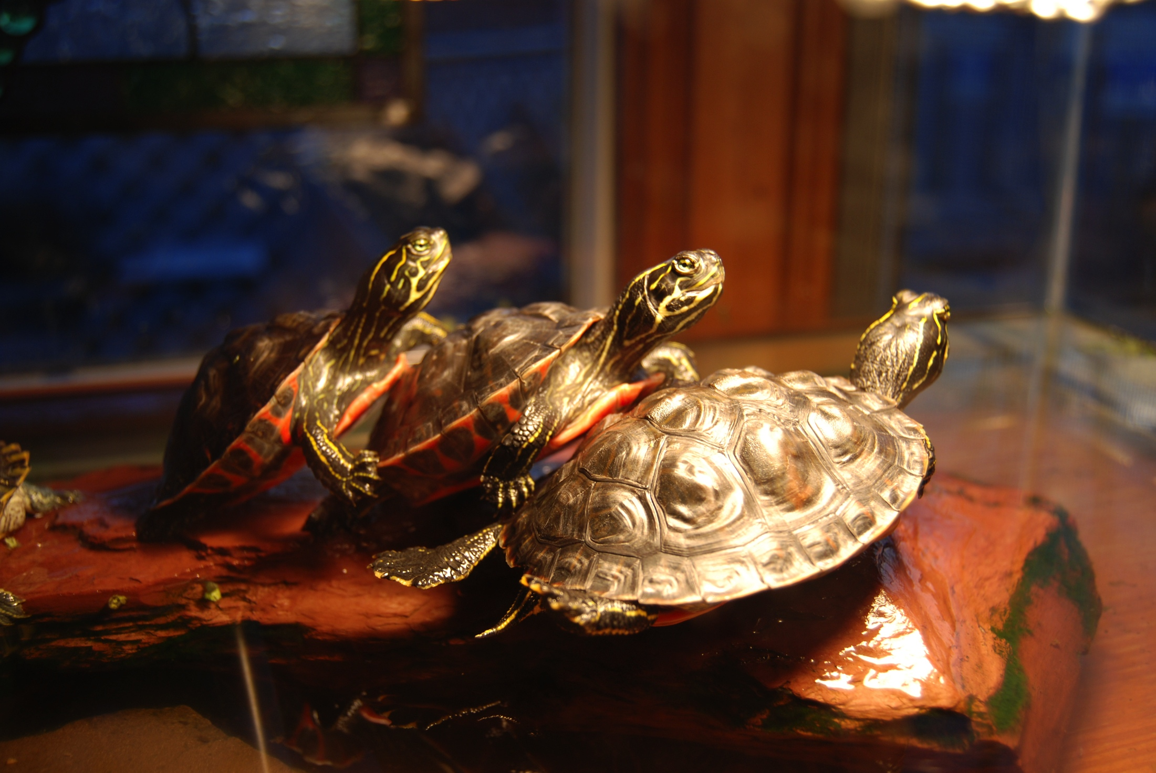
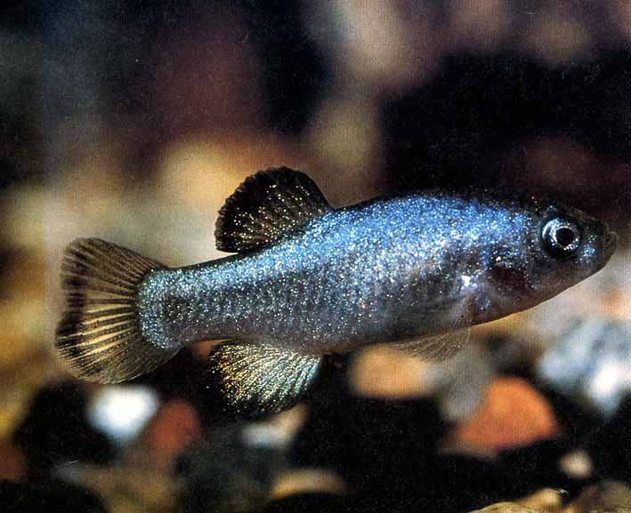
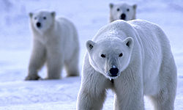
Ectotherm: animal whose body does NOT produce much internal heat (ex. fish, amphibians, reptiles)
Endotherm: animal whose body regulates its own temperature by controlling the internal heat

Slide 5
Mammals 4/15/15
Mammals- endothermic vertebrates with a four chambered heart and skin covered with fur or hair
Most are born alive
Young fed with milk produced from mother’s body (mammary glands)
Have specialized teeth
Herbivores- plant eating; incisors that cut and molars that grind
Carnivores- meat eating; sharp canines that tear flesh
Omnivores- plant and meat eating; use a variety of teeth

Slide 6
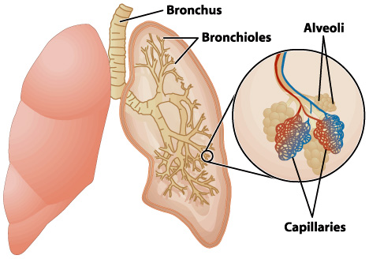
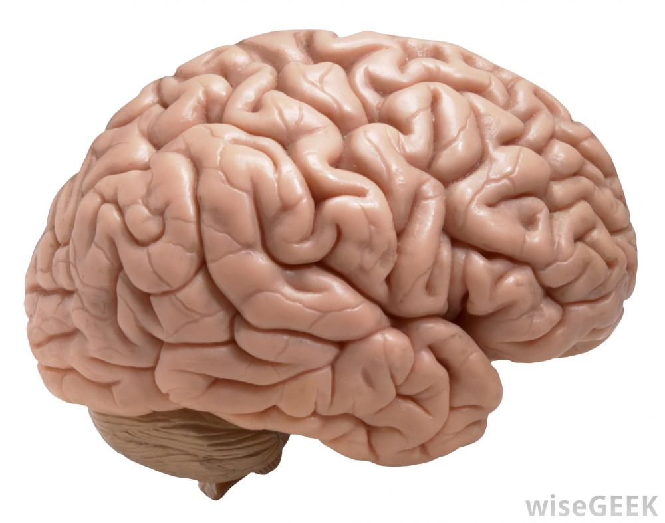
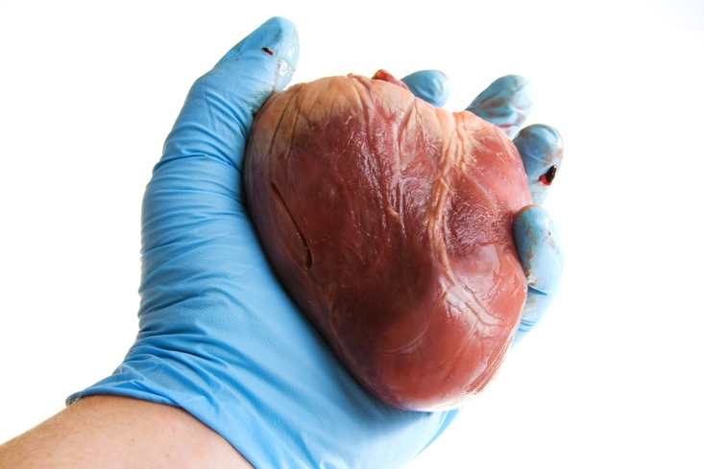
Have body systems
Well developed lungs with millions of alveoli
Four-chambered heart and two-loop circulatory system
Specialized ways of moving—walk, run, hop, swing, glide, fly and swim
Large brain and complex nervous system
Internal fertilization

Slide 7
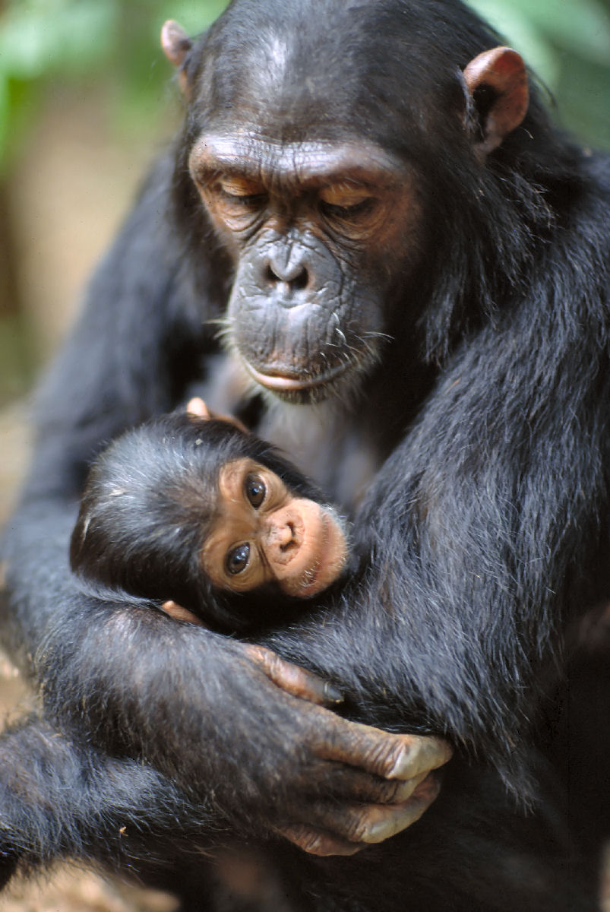
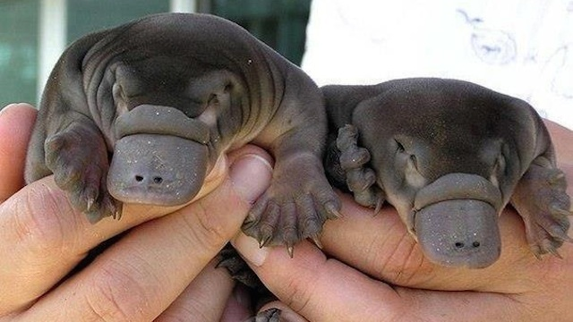
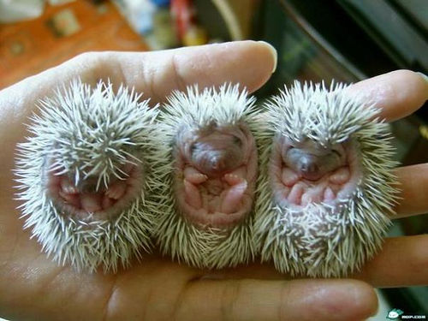
Have three main groups:
Monotremes- egg laying mammals that lack nipples (ex. Spiny anteater and duck-billed platypus)
Marsupials- mammals who give birth during early stage of development, then usually continue to develop in pouch on mother’s body.
Placental mammals- develop from embryo connected to a placenta by an umbilical cord; diverse group based on how they eat and move, as well as other characteristics.

Slide 8
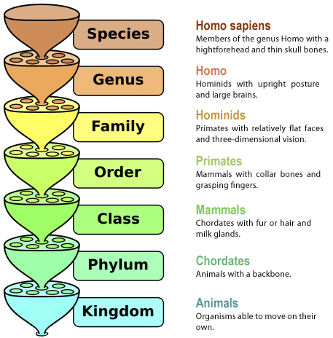

Slide 9
Question:
Why do mammals have skin?

Slide 10
The Skin 4/20/15
Skin- largest organ of the body that covers and protects the body from injury, infection and water loss.
Protection- forms a barrier to keep disease causing microorganisms and harmful substances our and water in.
Temperature- skin is composed of many blood vessels that can expand to allow more blood flow. Also contains sweat glands which produce perspiration to cool your skin.
Eliminating wastes- perspiration also contains dissolved wastes from the breakdown of proteins.

Slide 11
Two layers of tissue:
The Epidermis | The Dermis
Thin outer layer of skin which does not contain nerves or blood vessels Outer most cells are dead Cells produce melanin which is a pigment that gives skin color | Inner layer of skin between epidermis and fat Thicker than epidermis Contains sweat glands, hairs and oil glands Perspiration leaves the skin through pores and strands of hair grow in follicles

Slide 12
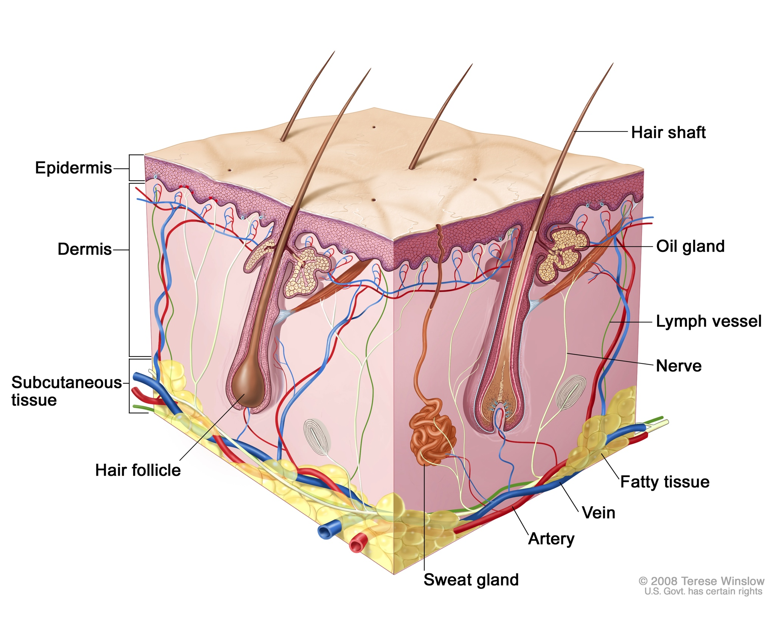
Skin is able to produce new cells and repair itself when injured.
Scabs form to prevent bacteria from entering
Skin cells beneath scab multiply to fill in gap of the torn skin
Skin grafts, pieces of skin used from one part of body to repair another in the case of severe skin damage.

Slide 13
Question:
What does muscle strength depend on?

Slide 14
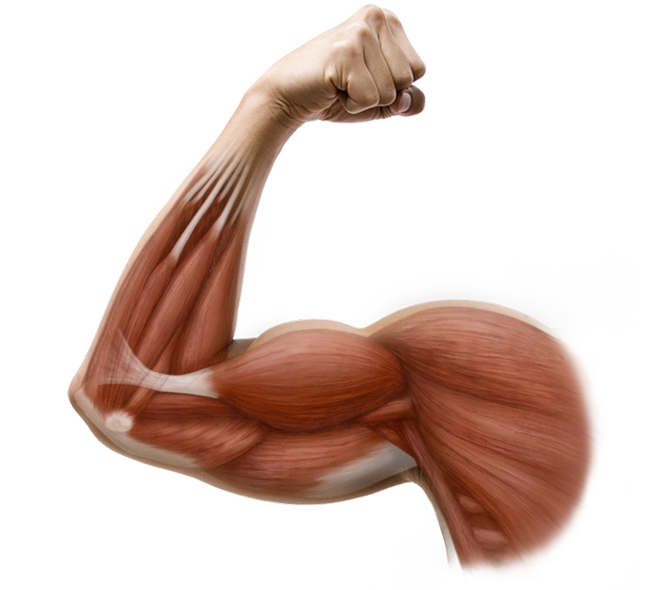
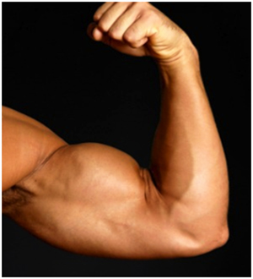
Muscular System 4/22/15
Muscle- an organ that can relax and contract providing the force to move your body
Voluntary muscle- muscles you can control
Involuntary muscle- muscles you CANNOT control

Slide 15
There are three types of muscle tissue:
Skeletal muscle- attached to bones of skeleton; have tendons or strong connective tissue attaching muscle to bone; classified as voluntary
Smooth muscle- found in internal organs; involuntary muscles that react more slowly and tire more slowly
Cardiac muscle- found only in heart; involuntary muscle that does not get tired; contracts repeatedly—contraction are your heartbeats

Slide 16
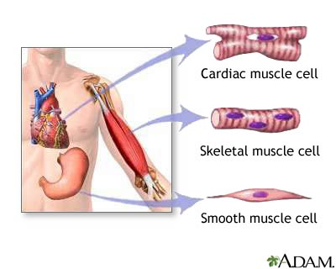

Slide 17
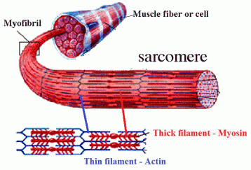
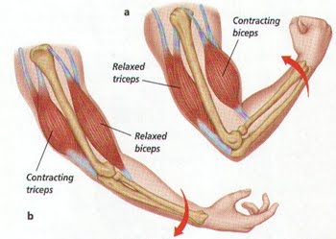
Because muscle cells can only contract, not extend, skeletal muscles must work in pairs. While one muscle contracts, the other muscle in the pair relaxes to its original length.
Muscle tissue is made up of fibers, or fused muscle cells. Each fiber is made up of smaller units called myofibrils, which are made up of even smaller protein filaments called myosin (thick) and actin (thin).

Slide 18
Question:
Why is calcium important in the human diet?

Slide 19
Skeletal System 4/22/15
Skeleton- made up of all the bones in your body; has five major functions
Gives shape and support to your body
Bones protect your internal organs
Major muscles are attached to your bones
Blood cells are formed in red marrow at center of bones
Calcium and phosphorus compounds are stored for later use by body

Slide 21
Bone structure- bones are alive, therefore they grow and develop
Periosteum- tough membrane covering bones surface
Compact bone- hard, strong layer under periosteum
Spongy bone- found towards ends of long bones with many small spaces within it
Marrow- soft, connective tissue found within spaces; two types red and yellow—red produces blood cells, yellow stores fat as energy reserve
Cartilage- rubbery layer of tissue found at ends of bones where they form joints

Slide 22
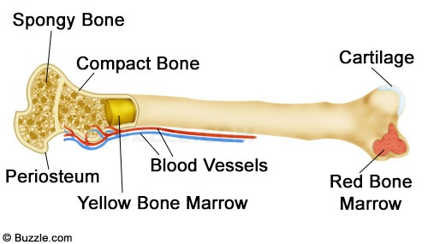

Slide 23
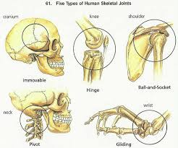
Joints- any place where two or more bones come together; held in place by tough band of tissue—ligament
Immoveable joints- allows little or no movement
Pivot joint- one bone rotates around another
Ball and socket- rounded end of bone fits into cup-like structure of another
Hinge joint- back and forth movement
Gliding joint- one part of bone slides over another

Slide 24
Question:
What two parts of the body make up the central nervous system?

Slide 25
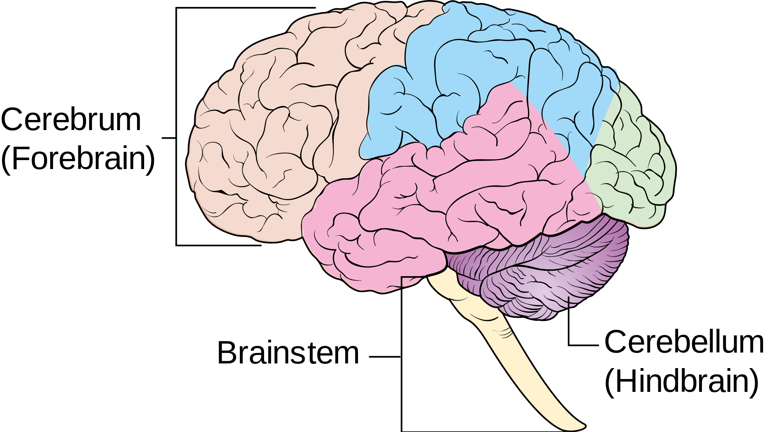
Nervous System 4/27/15
Nervous system- has two divisions that work together:
Central nervous system- consists of the brain and spinal cord and is the control center of the body
Brain- located in the skull has 3 main regions:
Cerebrum- largest part; controls movement, the senses, speech and abstract thought
Cerebellum- coordinates actions of muscles and helps maintain balance
Brain stem- controls involuntary actions such as breathing and heart rate

Slide 26
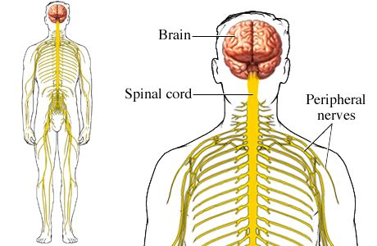
Spinal Cord- is the link between the brain and the peripheral nervous system
Peripheral nervous system- consists of a network of nerves that branch out from the central nervous system and connect it to the rest of the body
Reflex- automatic response that occurs very rapidly and without conscious control; helps to protect the body.

Slide 27
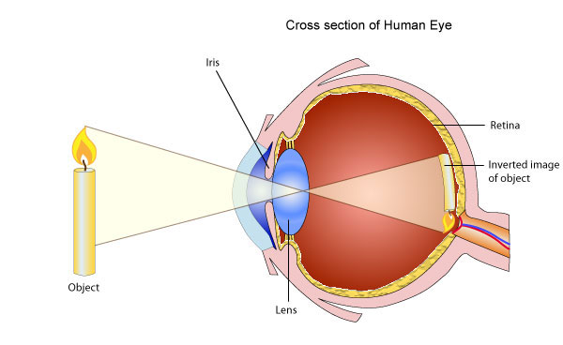
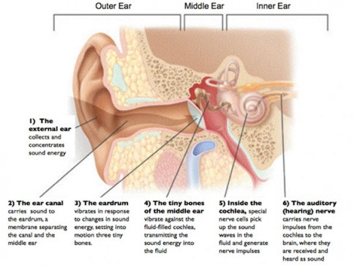
The body has five senses:
Vision- light enters your eyes and stimulates the rods and cones, or cells found in your retina→ they send impulses to optic nerve, brain interprets image you “see”
Hearing- ears pick up sound waves caused by vibrations that your brain interprets

Slide 28
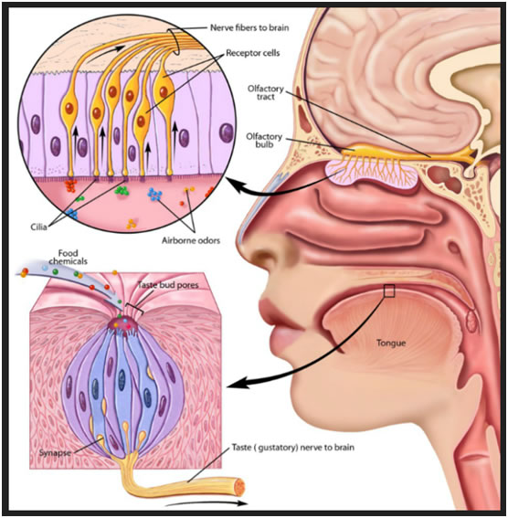
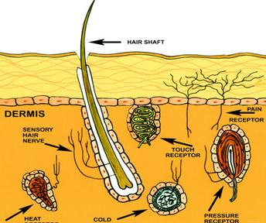
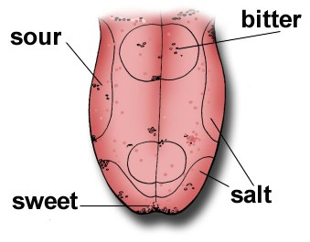
Smell and Taste- work closely together—depend on chemical trigger responses in receptors in the nose and mouth
Touch- sensory receptors pick up changes in touch, pressure, pain and temperature and send impulses to brain or spinal cord.

Slide 29
Question:
Why is the small intestine called “small” if it is 6m long?

Slide 30
Digestive System 4/27/15
Digestive system- main function is to disassemble the food you eat into molecules your body can use as energy.
The Mouth- food enters to begin digestive process
Mechanical digestion- food is chewed, mixed and churned.
Chemical digestion- process of changing food on a molecular level through the action of enzymes, or proteins that speed up chemical reactions in body.
The Esophagus- muscular tube moves food to the stomach using peristalsis, or waves of muscle contractions.

Slide 31
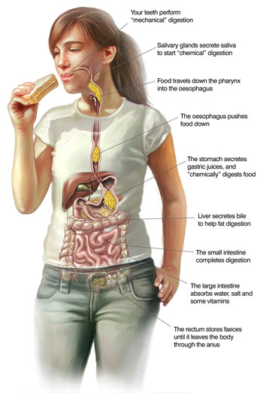
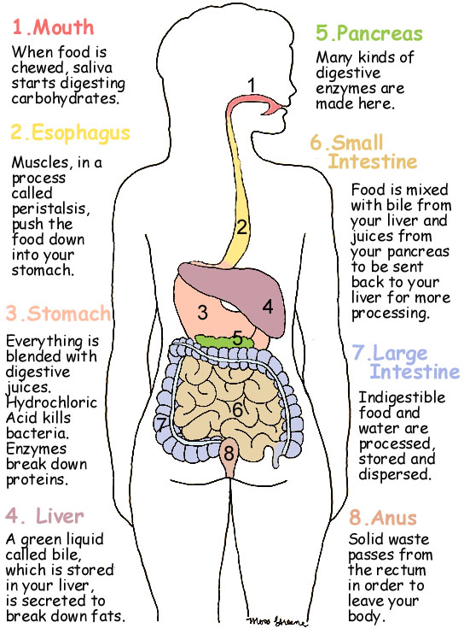

Slide 32
The Stomach- food is digested mechanically by peristalsis and chemically by digestive enzyme pepsin and hydrochloric acid.
The Small Intestine- most chemical digestion takes place here along with absorption of nutrients which is increased by villi, or small projections that increase surface area.
Liver- produces bile during digestion, a substance that breaks up fat particles which is stored in the gall bladder
Pancreas- produces enzymes that flow into small intestine that help break down starches, proteins and fats.
The Large Intestine- absorbs water from undigested chyme into the bloodstream. The remaining material is ready for elimination from body.

