Slide 1
Astronomy and Space
6th Grade Earth Science

Slide 2
Question:
What causes the cycle of seasons on Earth?

Slide 3
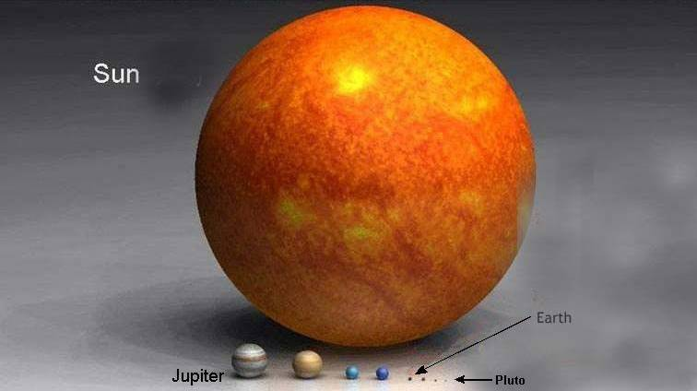
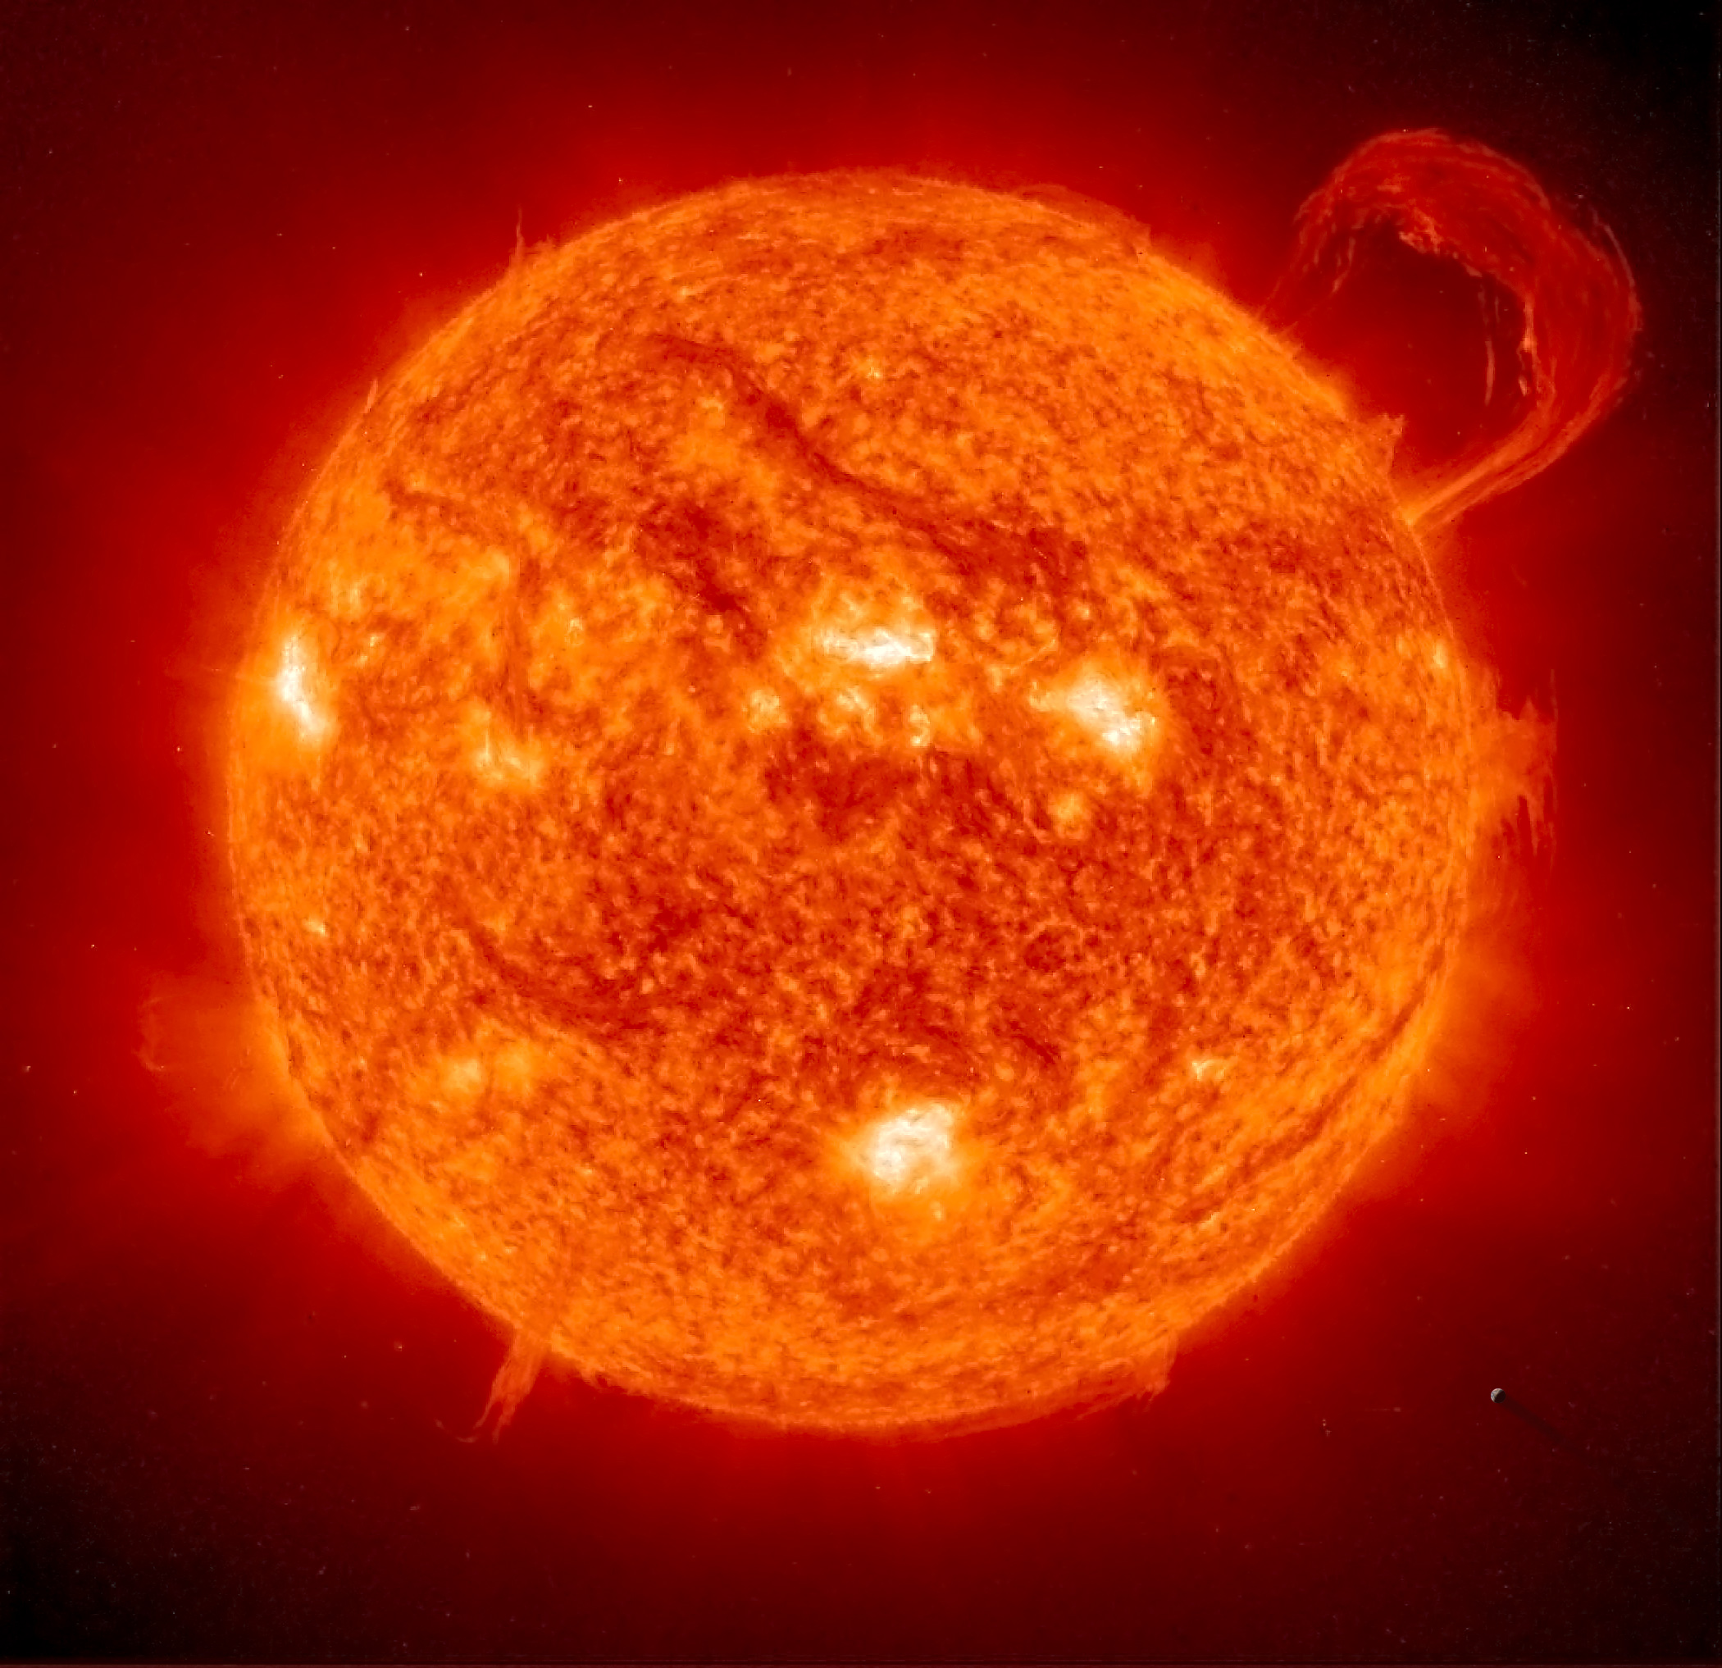
Earth’s Motion 4/28/15
The sun is the nearest star to Earth and has a diameter 100 times greater than Earth’s.
The sun’s core reaches temperatures over 15,000,000°C, with the surface reaching temps of 5,500°C.
A small part of this energy reaches Earth as light and thermal energy.

Slide 4
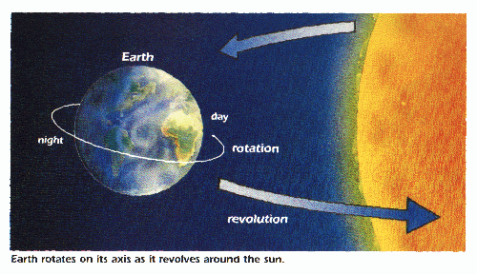
Earth orbits, or follows a path, around the sun making one complete revolution every 365.24 days dye to the Sun’s gravitational pull.
As Earth revolves around the Sun, it rotates, or spins on its rotational axis.

Slide 5
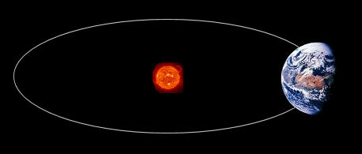
Because Earth’s surface is curved, different parts of the Earth’s surface receive different amounts of the Sun’s energy.
Earth’s orbit is an ellipse, or an elongated, closed curve. Because the sun is not centered in the ellipse, the distance between the Sun and the Earth change during the year.

Slide 6
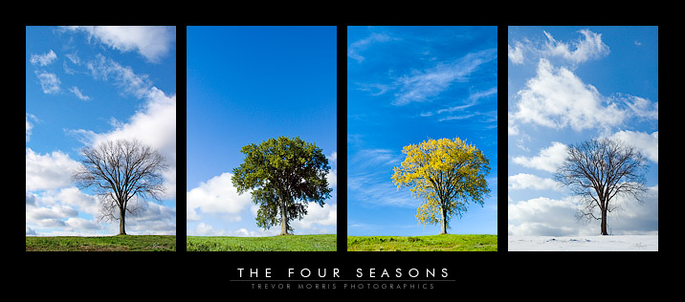
The tilt of Earth’s rotation axis, combined with Earth’s motion around the sun causes the seasons to change.
The hemisphere tilted toward the sun receives more daylight hours, thus more total sunlight, than the hemisphere tilted away from the sun.
Earth’s tilt causes the suns radiation to strike the hemispheres at different angles.

Slide 8
Solstice- day when Earth’s rotation axis is the most toward or away from the Sun
June (Summer) Solstice- June 20/21
December (Winter) Solstice- Dec 21/22
Equinox- day when Earth’s rotation axis is leaning along Earth’s orbit, neither toward nor away from the Sun
March (Spring) equinox- March 20/21
September (Fall) equinox- Sept 22/23

Slide 9
Question:
Why does the moon appear to change shape?

Slide 10
The Moon 5/5/15
The moon seems to shine because it reflects sunlight.
The gravitational pull of Earth on the Moon causes the Moon to move in an orbit around the Earth. The changing relative positions of the Moon, Earth and Sun cause the phases of the Moon, eclipse and tides.
Moon Data Compared to Earth
Mass | Diameter | Avg. Distance from Earth | Time of one Rotation | Time of one Revolution
12% of Earth’s | 27% of Earth’s | 384,000 km | 273 days | 273 days

Slide 11
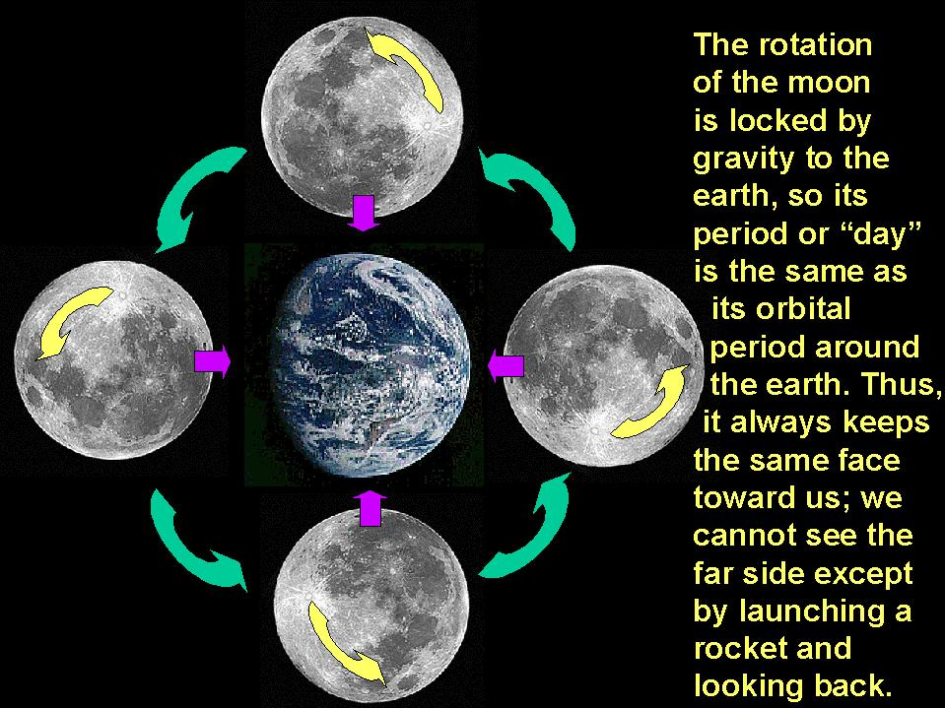

Slide 12
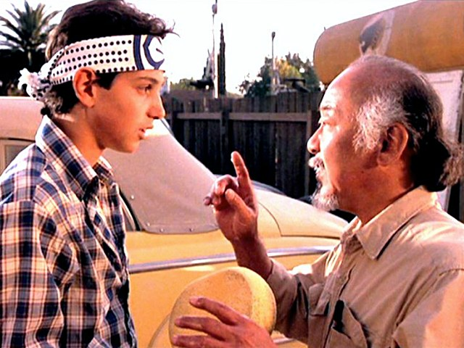
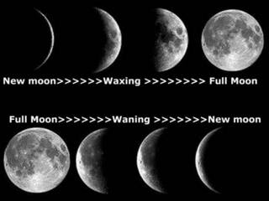
Phases- the different forms the Moon takes in its appearance from Earth; sequence of phases is the lunar cycle lasting 295 days
New Moon- when the moon is between Earth and Sun and can’t be seen
Waxing phases- more of the moon’s near side is lit each night
Waxing Crescent- first visible thin slice
1st quarter- half lighted
Waxing Gibbous- more than half
Full moon- all of lighted side visible

Slide 13
Waning phases- less of the moon’s near side is lit each night after a full moon
Waning Gibbous- more than half of lit side of moon still visible after full moon
3rd quarter- half of lighted side visible
Waning Crescent- last visible slice before a new moon

Slide 14
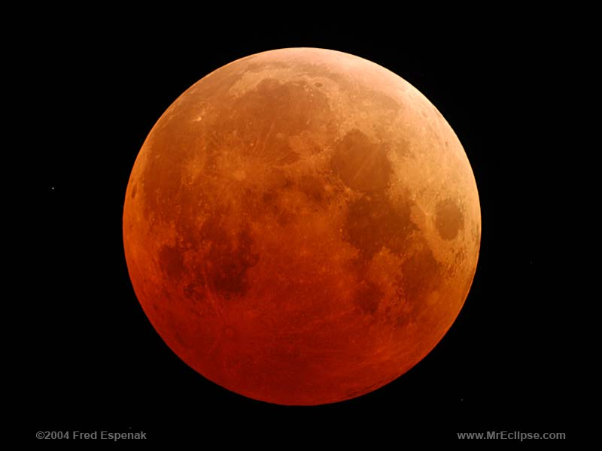
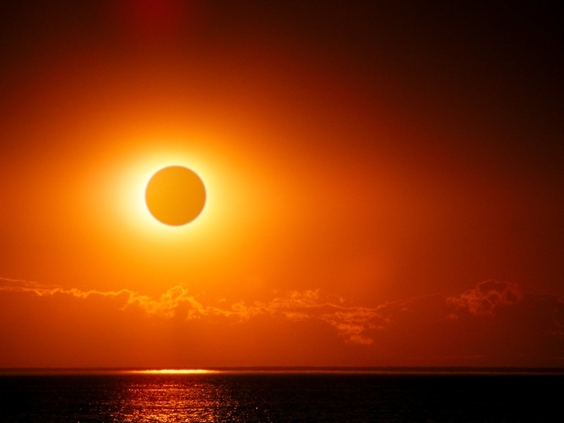
Eclipse- when Earth of the Moon casts a shadow on the other
Solar eclipse- when Moon’s shadow appears on Earth’s surface
Lunar eclipse- when the Moon moves into the Earth’s shadow

Slide 15
Question:
Why are planets classified as either inner or outer planets?

Slide 16
The Planets 5/7/15
Planets are classified according to their location in the solar system.
Inner planets: those with orbits between the sun and the asteroid belt.
Outer planets: orbit outside the asteroid belt.
Terrestrial planets: made mainly of rocky material
Gaseous planets: made mainly of ice and gas

Slide 17
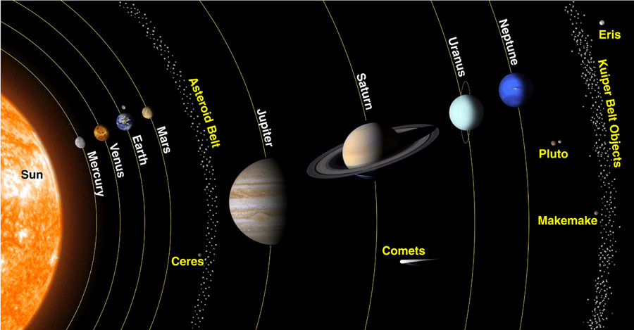

Slide 18
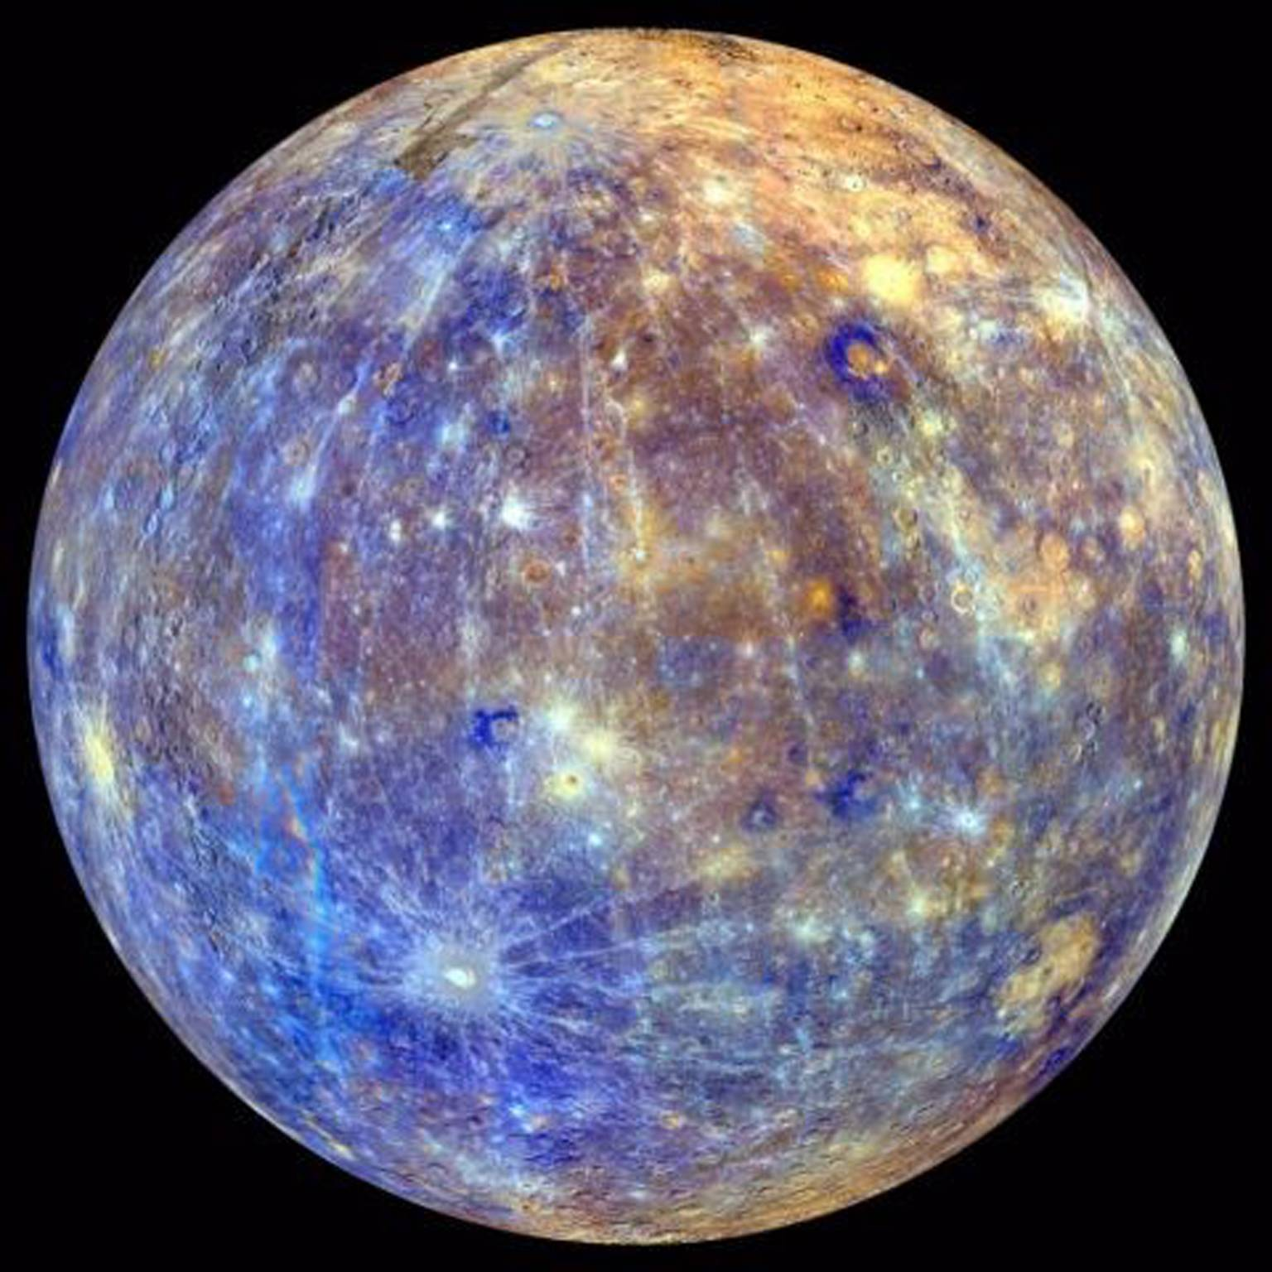
Mercury- planet closest to the Sun
Has no true atmosphere, surface temperatures are extreme
Has many craters and long, steep cliffs

Slide 19
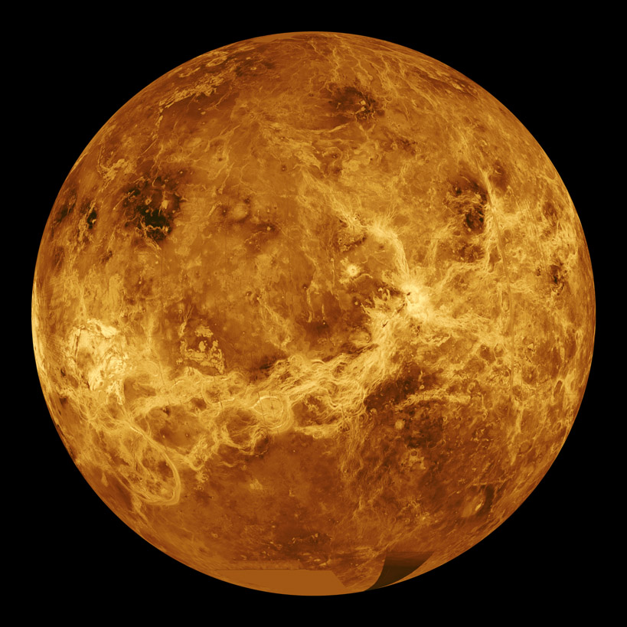
Venus- second from Sun and similar to Earth in size and mass
Extremely dense atmosphere of clouds causing intense greenhouse effect, resulting in surface temperatures between 450°C and 475°C

Slide 20
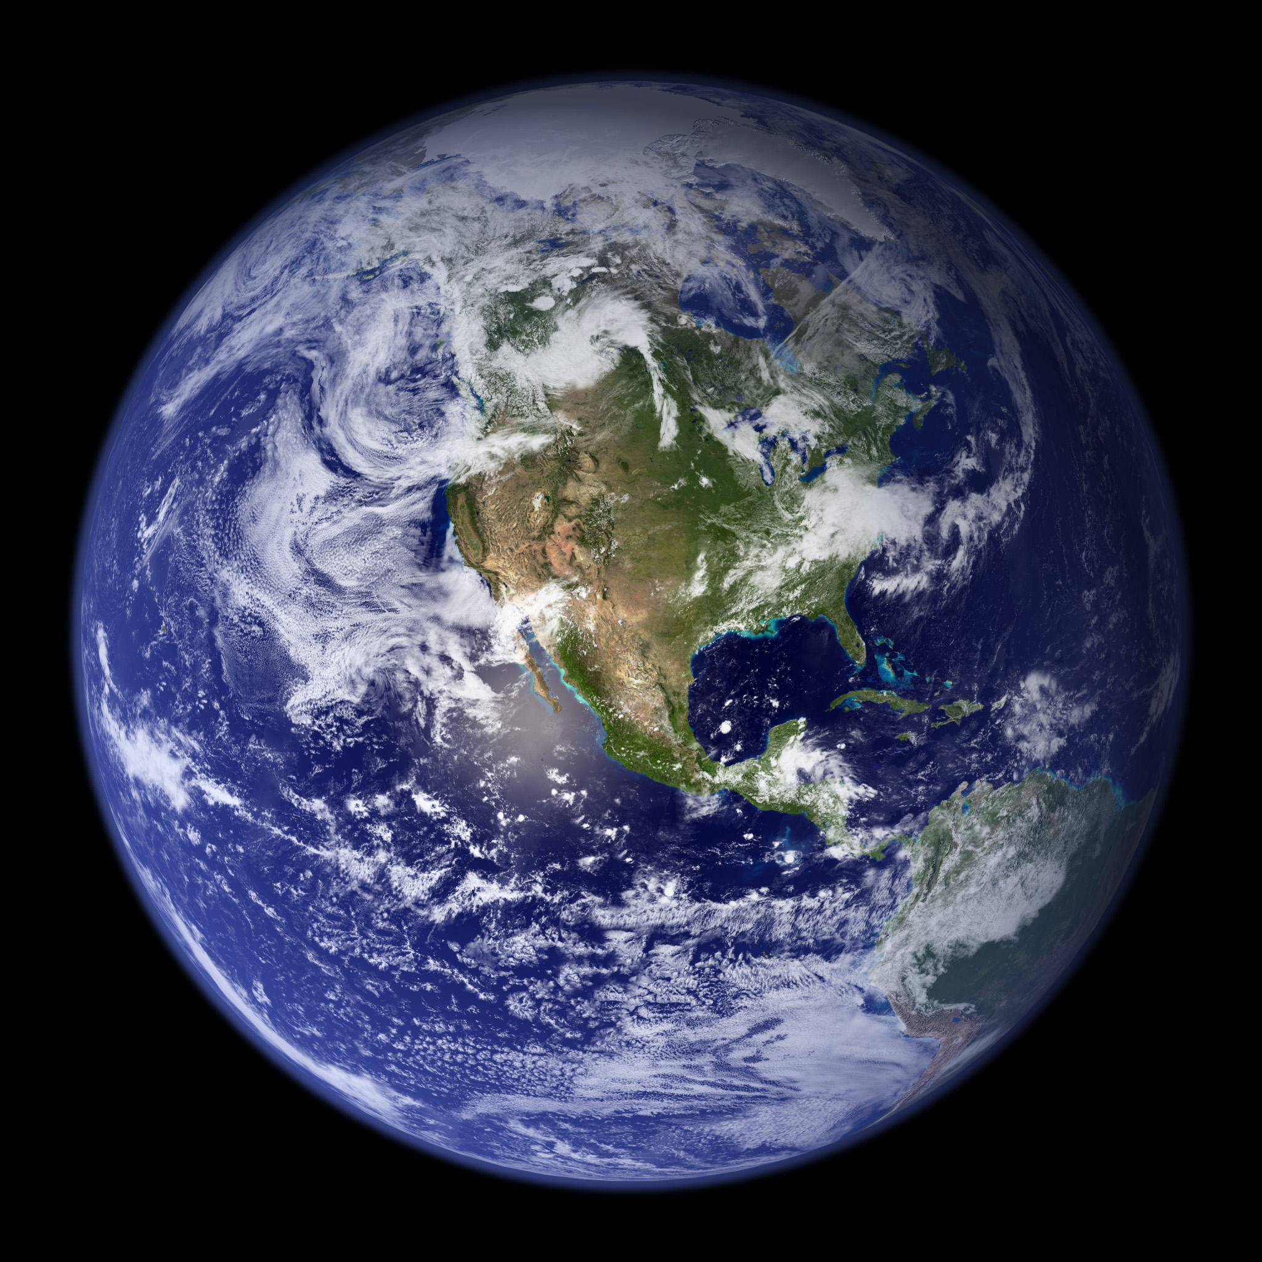
Earth- third planet from the Sun
Water exists on Earth as solid, liquid and gas
Atmosphere protects surface from meteors and Sun’s radiation

Slide 21
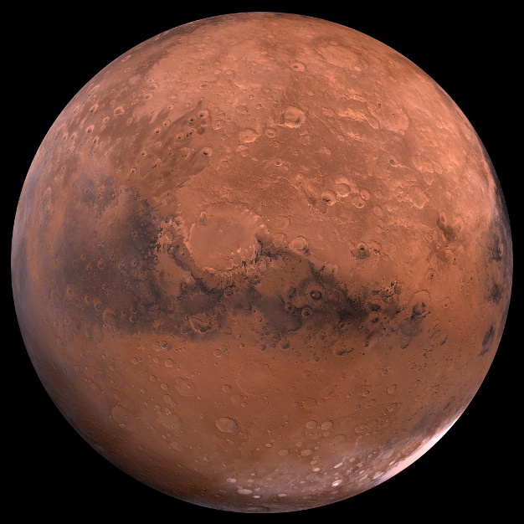
Mars- fourth planet from the Sun
Called the red planet because of the iron oxide that is present in the surface rocks giving them reddish color
Thin atmosphere causing extreme temperatures, strong winds, and global dust storms
Has polar ice caps, seasons, and other evidence that water is or was once present.

Slide 22
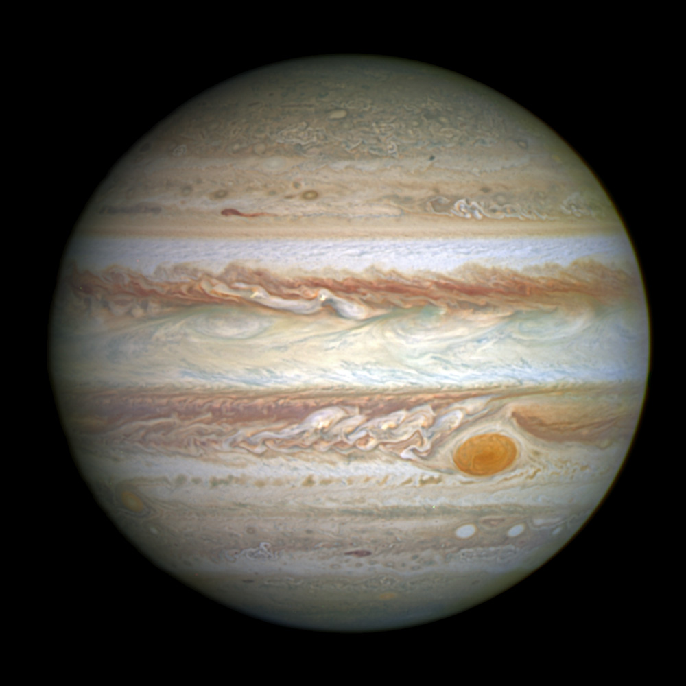
Jupiter- largest planet in solar system fifth from Sun
Atmosphere mostly hydrogen and helium; many high pressure gas storms with the most notable being the Great Red Spot
Has at least 60 moons with four having their own atmosphere

Slide 23
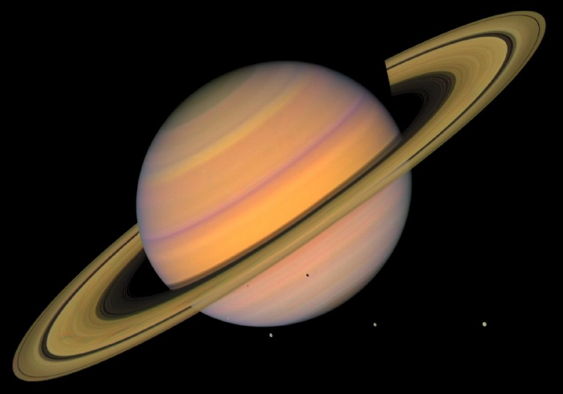
Saturn- sixth planet from Sun, second largest in solar system
Thick out rings of hydrogen, helium, ammonia, methane and water vapor
31 moons, with largest moon, Titan, being larger than Mercury

Slide 24
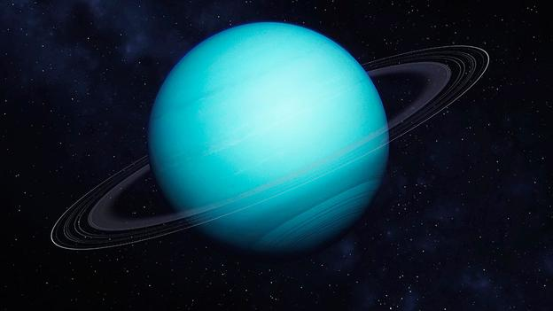
Uranus- seventh planet form the Sun; large and gaseous
Methane in atmosphere gives planet its blue-green color
Has tilted axis of rotation moving around Sun like a rolling ball

Slide 25
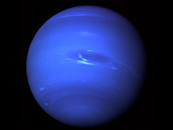
Neptune- eighth planet from the Sun
Has surface of frozen nitrogen and geysers that erupt nitrogen gas

Slide 26
Question:
How did the solar system come to be?

Slide 27
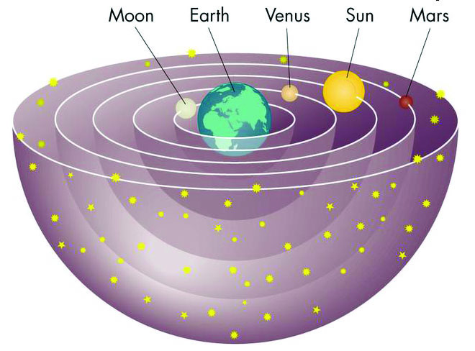
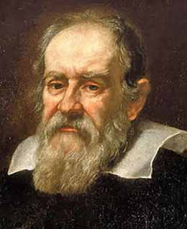
Solar System 5/14/15
Geocentric (Earth-centered) model- early Greeks thought planets, the Sun, Moon and stars rotated around the Earth
Heliocentric (Sun-centered) model- Nicholas Copernicus and Galileo Galilei observed that the Moon Revolved around the Earth and that Earth and the other planets revolved around the Sun.

Slide 28
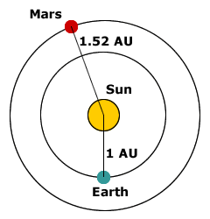
Astronomical Units (AUs)- measure distances among the objects in the solar system: 1 AU= 150 million km, the average distance from Earth to the Sun
Astronomers believe the solar system began 4.6 billion years ago.
A cloud of gas, ice and dust formed slowly
Shock waves (possibly from a supernova, or exploding star) might have caused the cloud to compress

Slide 29
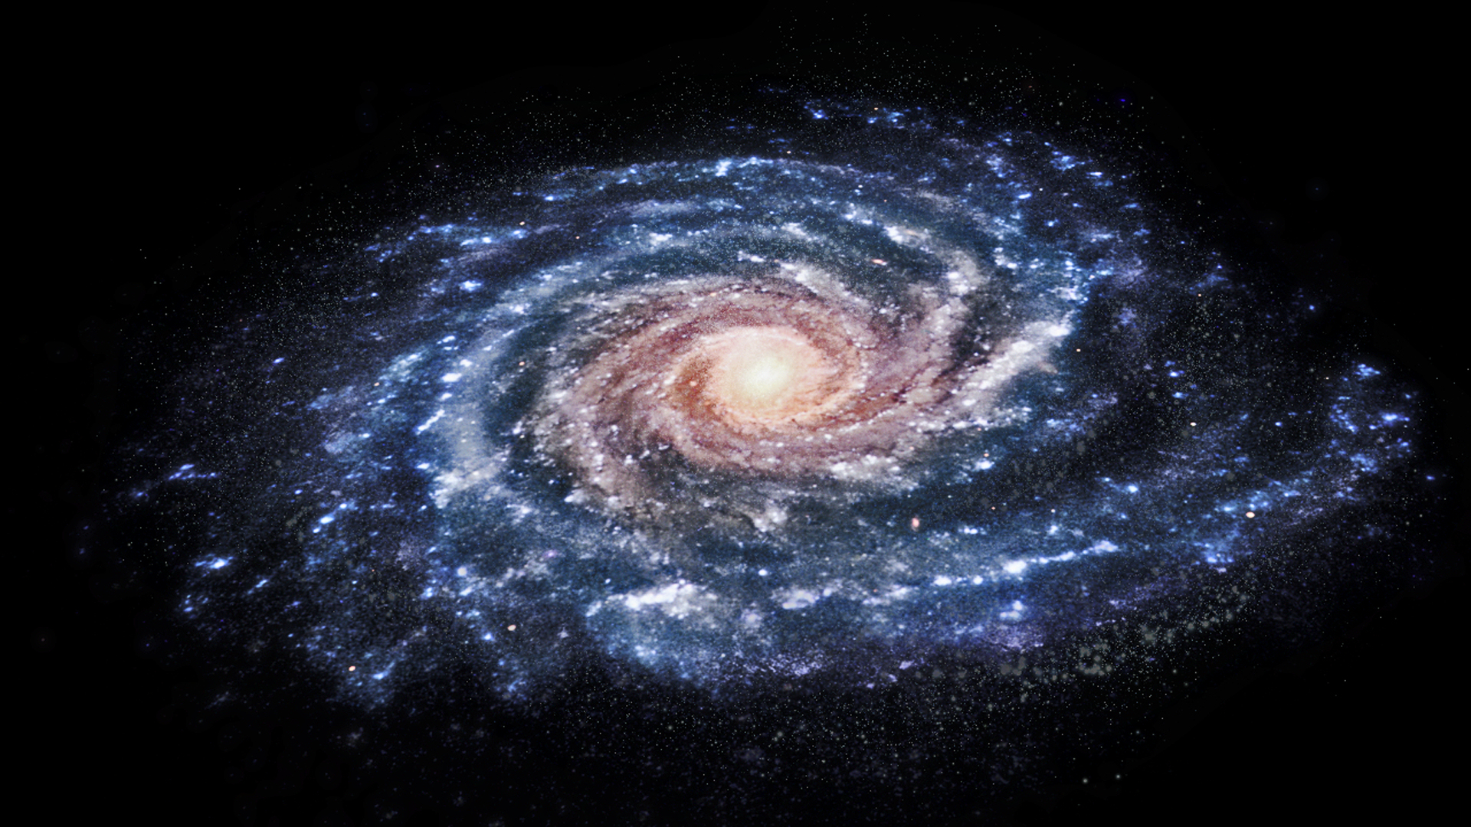
Cloud became more dense, rotated faster, heated up, and flattened to form a disc
Heated material from contracting cloud triggered nuclear fusion forming the Sun, material left behind became objects of solar system.

Slide 30
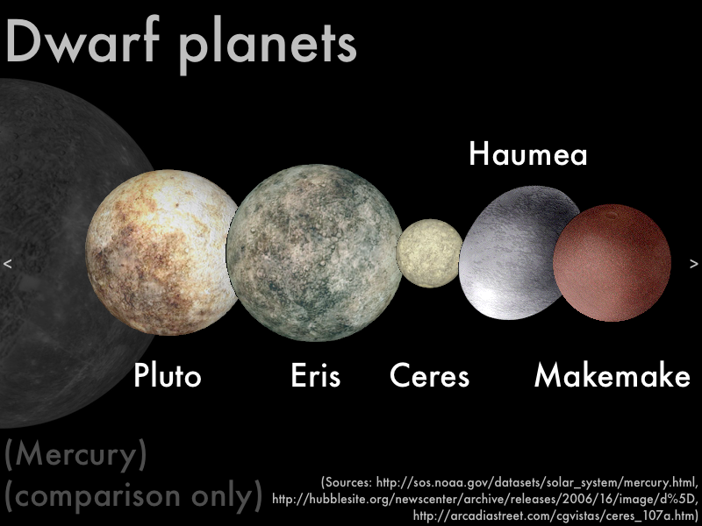
Objects that orbit the Sun:
Planets- a planet must orbit the Sun, have a nearly spherical shape and have a mass much larger than the total mass of all other objects
Dwarf Planets- spherical shaped object that orbits the Sun but does not have more mass than the objects than the objects in nearby orbits

Slide 31
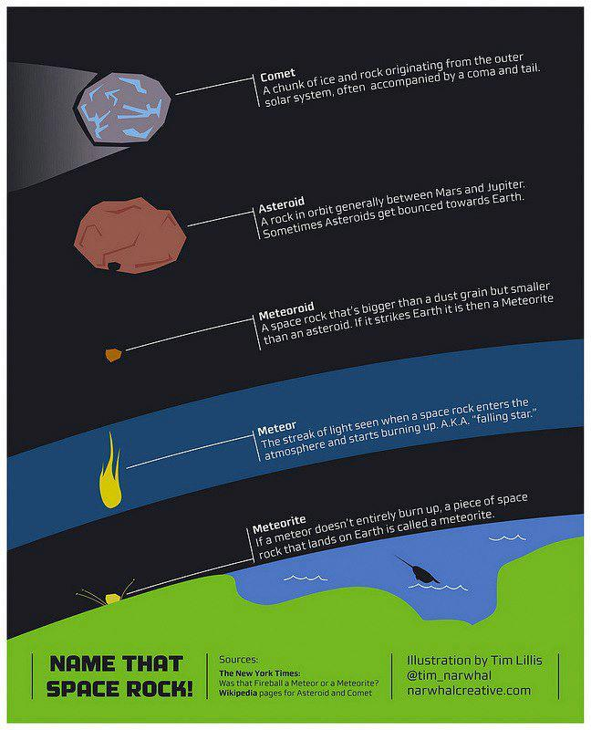
Asteroid- millions of small, rocky objects that orbit the Sun in an asteroid belt, range in size from <1 meter to several hundred km
Comet- made of gas, dust and ice and moves around the Sun in an oval-shaped orbit
Meteoroids- debris left by colliding asteroids or dispersing comets

Slide 33
Question:
What does the life of a star depend on?

