Slide 1
Question:
What is genetic drift?

Slide 2
Evolution of Populations 3/11/15
Genetically speaking, evolution is a change in the frequency of alleles in a population over time.
Three sources of genetic variation:
Mutations—change in genetic material of a cell
Genetic Recombination—during sexual reproduction each chromosome in a pair moves independently during meiosis—in humans this can produce over 8,000,000,000 gene combinations.
Lateral gene transfer—passing of genes from one organism to another (not including offspring)

Slide 3
Gene pool—consists of all genes, including all the different alleles, that are present in a population
Hardy-Weinberg Principal—states that allele frequencies will remain constant, or have genetic equilibrium, unless factors cause those frequencies to change.
The Hardy-Weinberg Principal holds under these five conditions:
Random mating
Very large population
No movement in or out of population
No mutations
No natural selection

Slide 4
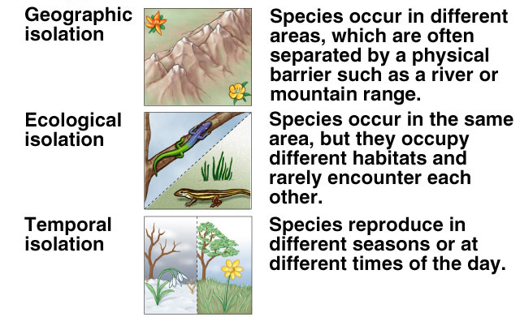
Reproductive isolation, or when two populations no longer interbreed, can cause evolution of two separate species. This can be caused by behavioral isolation, geographic isolation and temporal isolation.

Slide 5
Question:
How does the fossil record provide evidence for the theory of evolution?

Slide 6
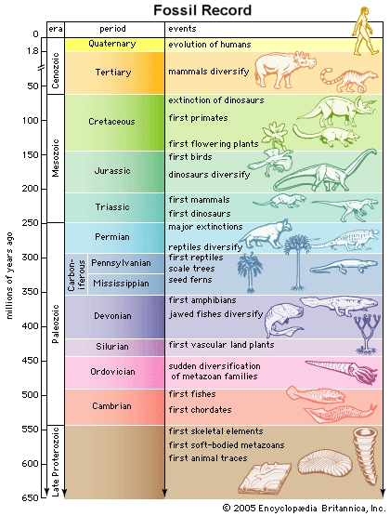
The Fossil Record 3/11/15
Paleontologist—scientist who studies fossils, or the preserved remains or traces of organisms that lived in the past.
Fossil record—collections of fossils organized to proved evidence about history of life on Earth, including how organisms have changed overtime.

Slide 7
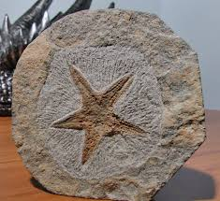
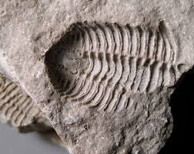
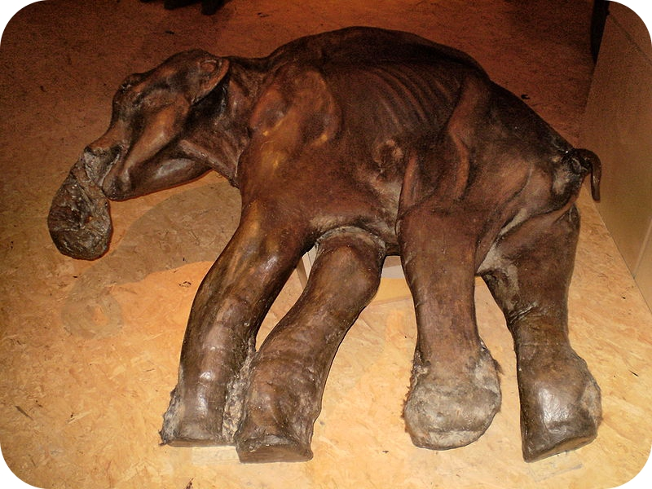
The formation of fossils are rare events but can occur by:
Petrified fossils | Molds and Casts | Preserved Remains
Remains are buried in sediment then change to rock over time | Hollow spaces in sediment in the shape of an organism is called a mold; when a mold becomes filled with hardened materials it becomes a cast | Quickly buried organisms are preserved by ice, volcanic ash or clay before they begin to decay

Slide 8
Relative Dating:
Age of fossils are determined by comparing its placement with that of fossils in other layers of rock
Radioactive Dating:
Involves measuring the amounts of radioactive isotopes in a sample to determine its actual age
Paleontologists use the geological time scale or a “calendar” of Earth’s history, to represent evolutionary time.
After Precambrian Time, the geological time scale is divided into eras (Paleozoic, Mesozoic and Cenozoic) and those are subdivided into periods, which range in length from tens of millions of years to less than two million years.

