Slide 1
Evolution
7th Grade Life Science

Slide 2
Question:
How does natural selection lead to evolution?

Slide 3
Darwin’s Theory of Evolution 3/9/15
Evolution—the process of change over time
In Darwin’s travels aboard the HMS Beagle, which began in 1831, Charles Darwin made three important observations:
The world includes tremendous diversity of living things throughout a wide range of habitats
Animal species, like those in the Galapagos Islands, that are related, can have different characteristics or occupy different habitats in the same area.
Fossils—preserved remains of ancient organisms, resembled many organisms alive today.

Slide 4
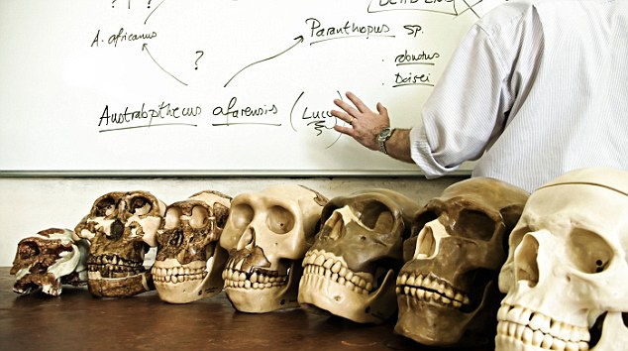
Darwin’s observations led him to develop the scientific theory of evolution, which explains how modern organisms evolved over long periods of time by natural selection.
Notes:
What is a theory?
Theory: well-tested concept that explains a wide range of observations
Evolution: gradual change of species over time

Slide 5
Adaptation—a trait that helps an organisms survive and reproduce
Natural selection—process by which individuals that are better adapted to their environment are more likely to survive and reproduce than other members of the same species.
→Factors that affect process of natural selection:
Overproduction—species produce more offspring than can survive
Variation—difference between individuals
Competition—resources are limited, species must compete to survive

Slide 6
Theory
Natural selection
Adaptation
Fossils
Evolution
Competition

